Slide 1

Southern CT State University
TRAVEL
Updated 10/3/25

Slide 2
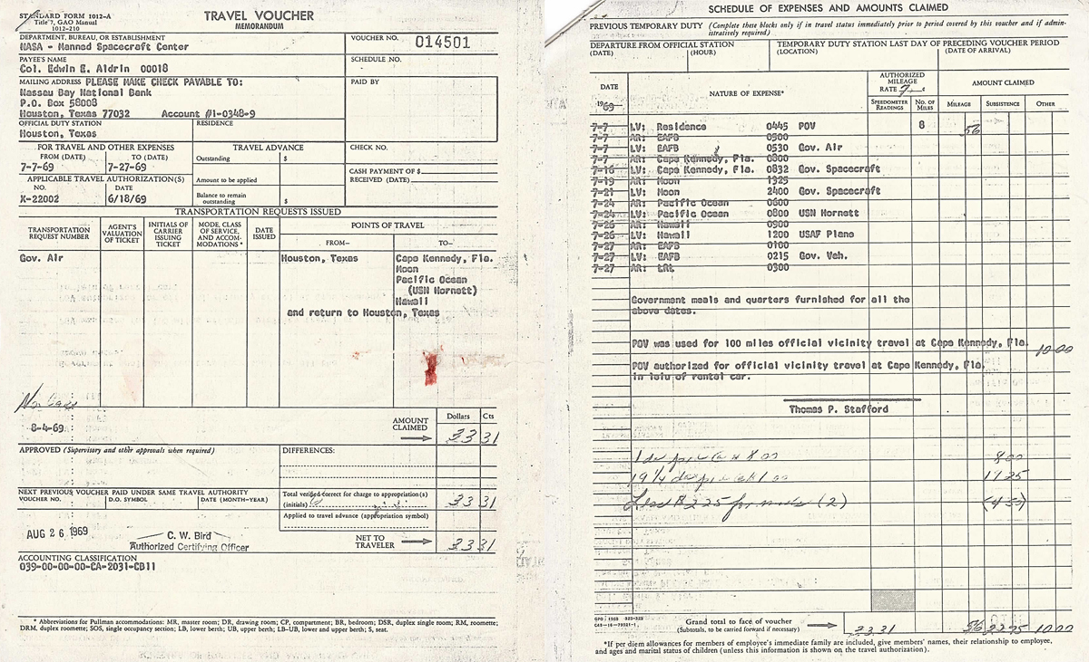
Travel Reimbursement

Slide 3
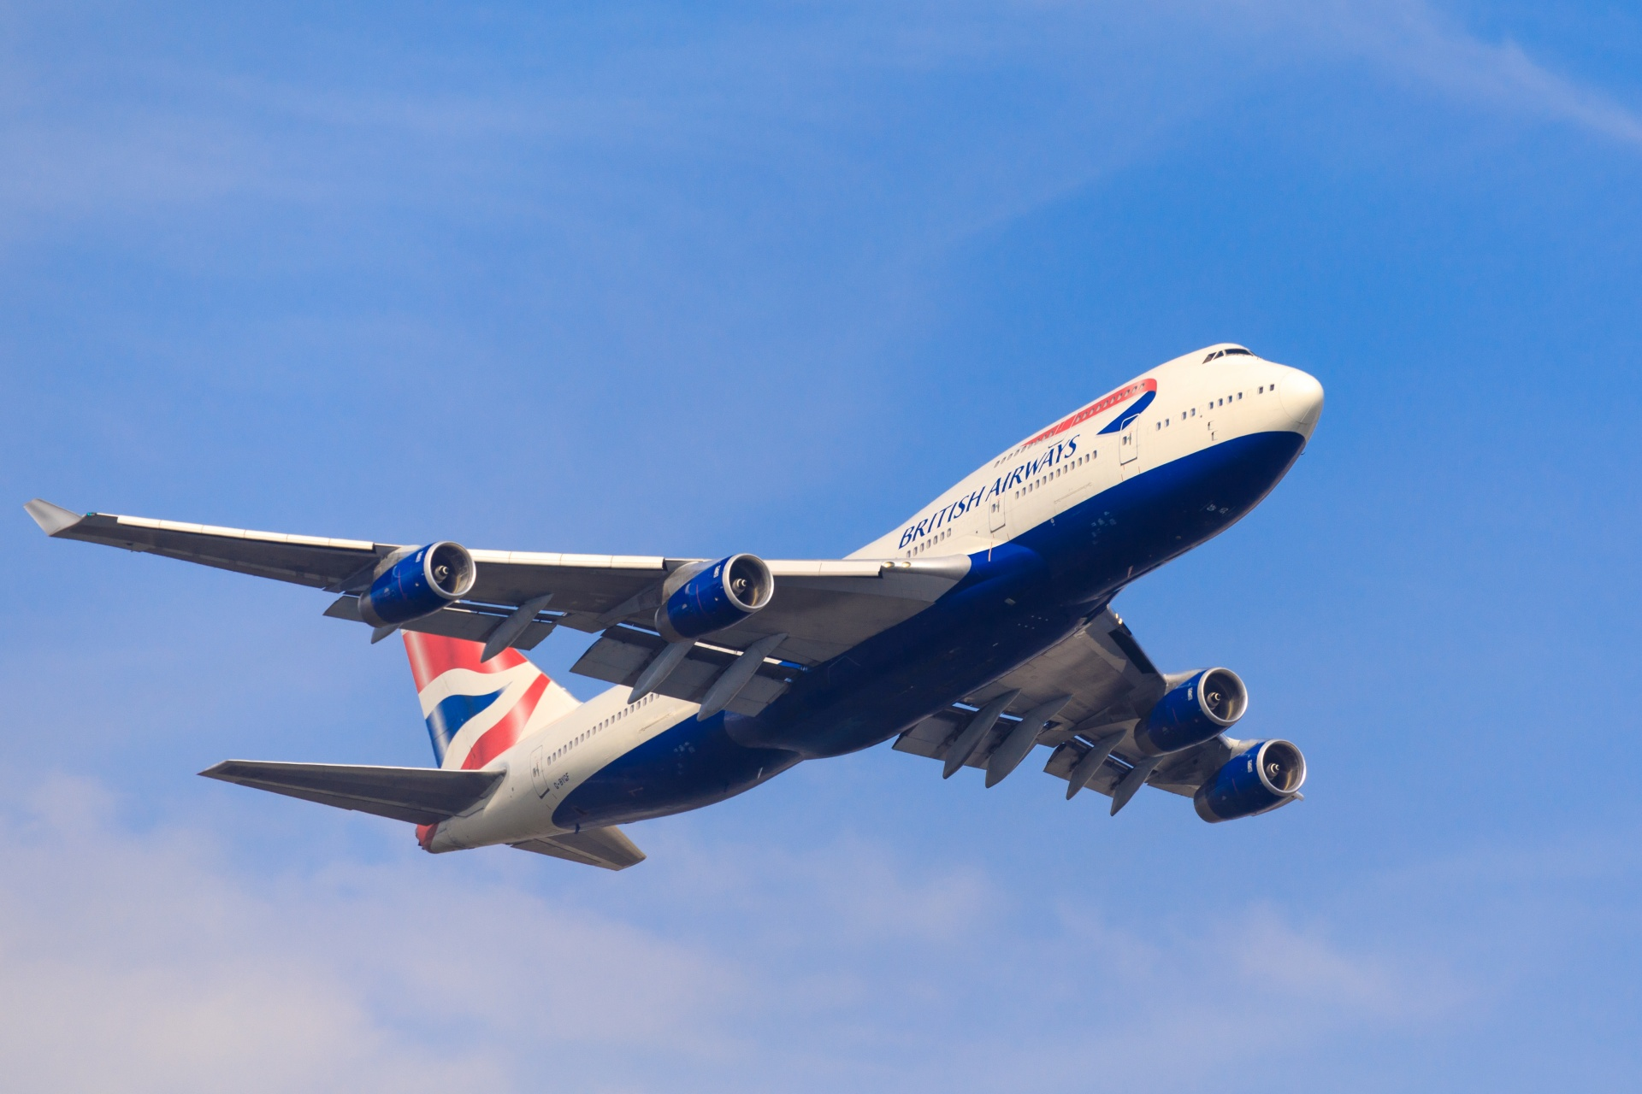
TRAVEL AUTHORIZATION
The Travel Authorization (TA) supports travel for official university business and supports workers compensation should an accident occur.
TA policies pertain to all employees and students traveling for the Connecticut State Colleges & University (CSCU) system, as well as other individuals representing CSCU.
Lowest cost option.
TRAVEL COMPONENTS
Approval of Travel via submission of a Travel Authorization
The actual trip
Completed CO-17XP form submission of actual expenses incurred by the traveler submitted to the Travel Office within 30 calendar days of completion of the trip.

Slide 4
DO I NEED A TA?
In-State Travel | Mileage only | No TA
 | Non mileage expense < $50 | No TA
 | Non mileage expense > $50 | TA
Out-of-State Travel | Travel within the US | TA
 | “No Cost” *Outside Organization | TA
 | Foreign Travel | TA
P-Card | Travel paid for with a P-Card | TA
Virtual | Virtual Conference | TA if reimbursement is >$50
Virtual using AAUP Funds
TA
4

Slide 5
SUBMISSION TIMELINE
An approved TA must be submitted to the Travel Office at least two weeks prior to travel. Failure to submit within this timeframe does not give the Travel Office sufficient time to process advances or prepayments when requested.
Late TA submissions must be documented on the Policy Exception Request Form and approved by the traveler's supervisor. Any TA received after travel has begun is not guaranteed to be reimbursed
SUPPORTING DOCUMENTATION
Copies of documents supporting the travel must be included with the TA. Documents may include conference announcement showing the name, location, dates, schedule, registration fee, and hotel fees (when applicable)

Slide 6

POLICY ITEMS TO KEEP IN MIND
Airfare:
Employees should purchase the lowest commercial fare available- the least costly, coach-class fare that uses a regularly scheduled commercial carrier.
Travelers should not consider their preference for airline, type of aircraft, or connecting airports.
Travelers may not insist on non-stop flights.
Baggage fees will be reimbursed for one (1) piece of checked baggage each way.
Lodging:
Under no circumstances will lodging be paid for a guest or spouse unless they are also travelling on approved University business.
The traveler should obtain the lowest cost lodging possible. In the case of a conference, travelers are permitted to stay at the conference hotel.
Travelers can arrive one day before the event and stay one day after the event.
Lodging is not entitled when travel distance is less than 75 miles one way.
Meal Reimbursement:
Based on per diem rates.
Reductions applied when meals are provided at no cost during events.
Car Rentals:
Use approved rental agencies.
Select the most economical vehicle suitable for the trip.

Slide 7
TA APPROVALS
Traveler | Traveler certifies that the travel is necessary to the business of the University, expenditures are in compliance with travel policies and no personal expenses are included.
Supervisor | The supervisor is certifying that the travel is necessary the business of the University, expenditures are reasonable, and arrangements have been made to cover position requirements.
Budget Authority | The budget authority (Financial Manager) certifies that the funds are available and has the option of declining any portion of the trip.
Travel Office | The Travel Office will verify supporting documents, and that the request is in compliance with travel policies. The Travel Office can decline any part of the request based on non-compliance.
 | Multiple indices need appropriate approval signatures.
Additional approval may be needed for:
Grant Funds
AAUP
MRMC
SUOAF

Slide 8
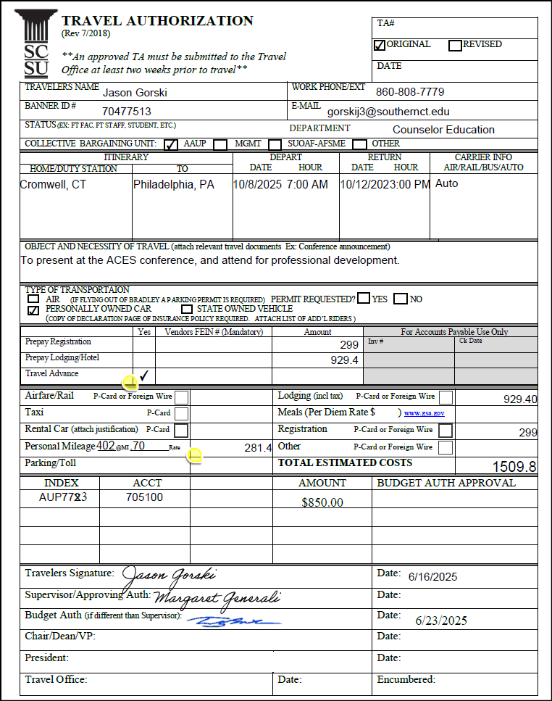

Slide 9
REVISIONS
CANCELLATION
TA Revisions are needed if additional funds are needed.
Include the original TA number assigned. The revised TA should be submitted along with the completed reimbursement form with all supporting documentation for reimbursement.
The revised TA requires signatures only for new funding sources or increases in funding amounts.
Cancellation of a TA may be made by email to Travel@southernct.edu.
Cancelling a TA will release encumbered funds. Non cancelable costs of the trip will be the responsibility of the traveler unless the cancellation is approved by the traveler's supervisor.

Slide 10

INSURANCE - PERSONALLY USED VEHICLE
Employees authorized to travel on State business using their personal vehicles must submit , prior to reimbursement, a copy of the Declaration Page of the insurance policy which covers the vehicle(s) to be used, showing policy limits, the names of the insured, and the effective dates of coverage. Insurance must meet the minimum liability as required by the State regulations. Those minimums currently are:
Bodily Injury Liability: $50,000 each person/$100,000 each occurrence; and $5,000 in property damage
Alternatively, in lieu of the above, a combined $105,000 minimum for bodily injury and property damage is acceptable.
An insurance card, billing invoice or copy of homeowners policy is unacceptable.
Updated insurance documents should be submitted as the policy expires and a travel event occurs.

Slide 11
MILEAGE
Mileage from point-to-point will be determined through the use of MapQuest, Google Maps, or equivalent web site.
A copy of the mileage (start to finish of each location) must be printed and submitted with the travel reimbursement request. Reimbursement will not be processed without this documentation.
Transportation of any kind between an employee’s home and official duty station is not reimbursable, with the exception of part-time supervising faculty (e.g. student teaching supervisors, cooperating student supervisors, clinical education supervisors).
The roundtrip mileage between the employee’s home address and SCSU (501 Crescent St. New Haven, CT) will be deducted. (*Unless travel occurs on a weekend day.)
Travel between CSCU campuses must use the mileage chart provided on the Southern travel policy document located on the SCSU Accounts Payable Travel webpage.

Slide 12
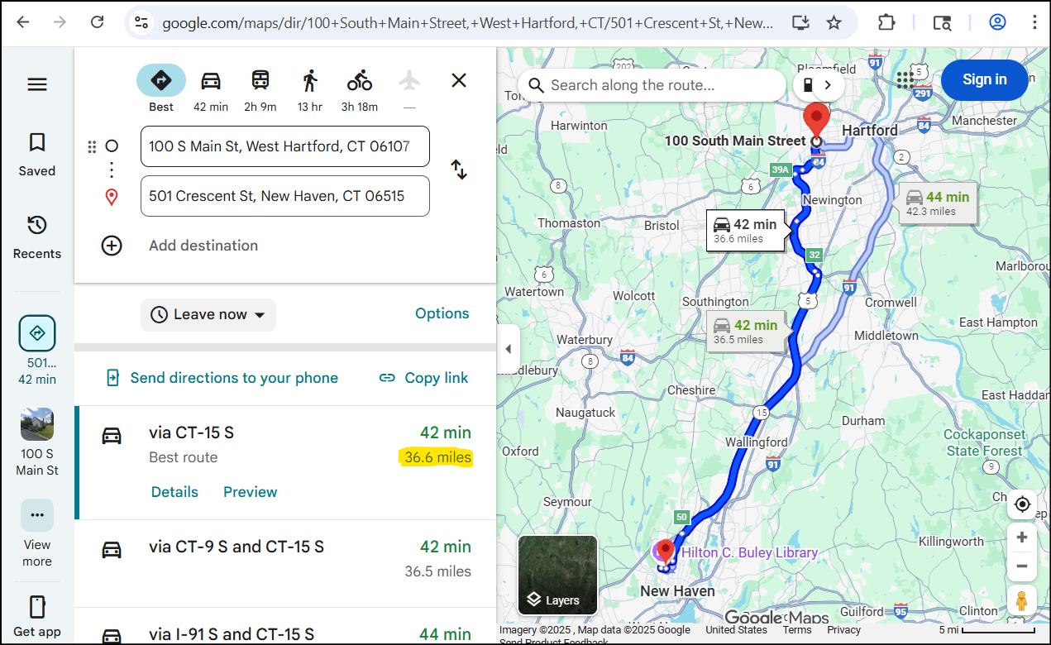
MILEAGE DOCUMENTATION

Slide 13
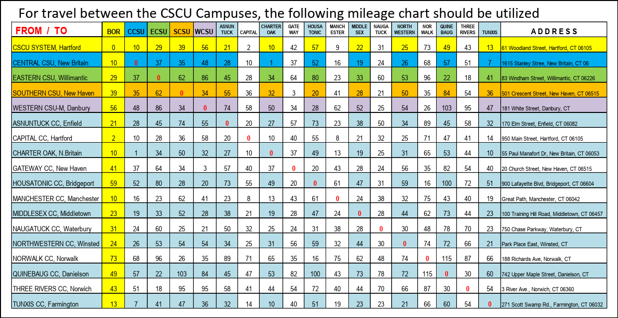
MILEAGE DOCUMENTATION

Slide 14
TRAVEL EXPENSE CATEGORIES
Airfare
Baggage Fees
Rail Travel
Car Rental
(Needs Justification and prior approval)
Other Transportation (Taxi, Uber, etc)
Lodging
Meals
Business Office charges (phone, Internet, etc)
Parking Permits
Conference & Registration Fees
Other

Slide 15
TRAVEL REIMBURSEMENT – CO17XP
Expenses incurred by the traveler must be submitted to the Travel Office within 30 calendar days of completion of the trip. Travelers should submit a Travel Reimbursement Form CO17xp with all applicable original receipts showing proof of payment.
Acceptable forms include:
A paid itemized receipt
A paid itemized receipt e-mailed directly to the Travel office by the sponsoring organization
A copy of both sides of a cancelled check or the original cancelled check
A copy of a bank statement or a printed electronic bank statement along with a copy (photocopy or duplicate check copy) of the front side of the check. *
A print-out of a web-banking statement indicating the payee and amount paid. *
*personal bank account numbers and credit card numbers should made illegible on documentation for your personal protection
If any of the required receipts are missing or lost, a Policy Exception Request must be attached to the Travel Reimbursement form. Failure to submit a Travel Reimbursement form will jeopardize an individual’s ability to obtain further advances or reimbursements for subsequent trips.

Slide 16
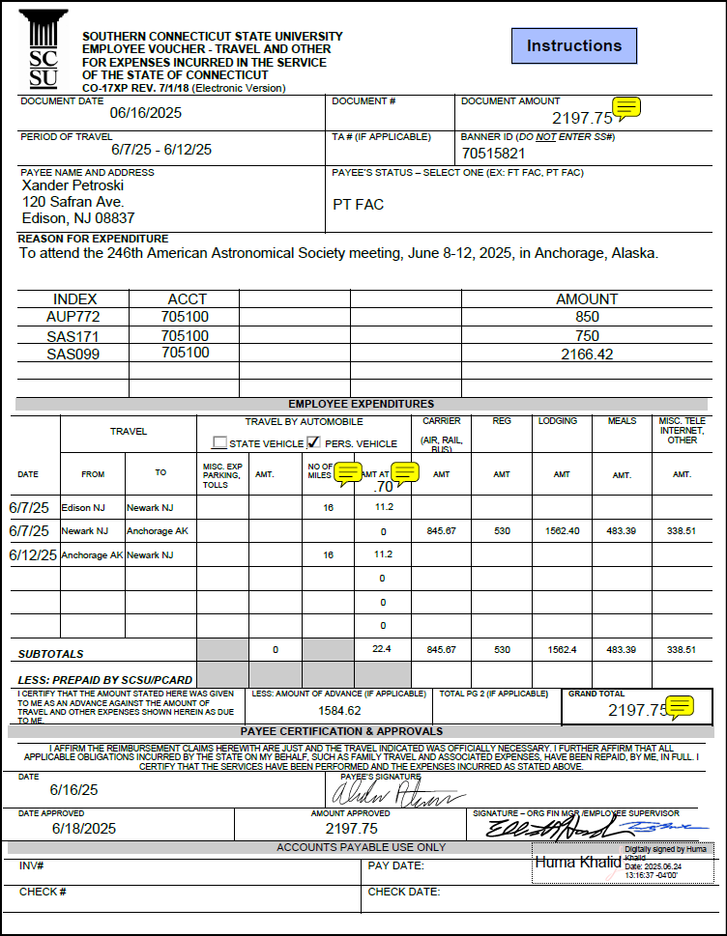
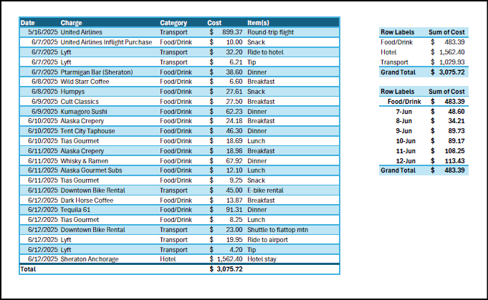
TRAVEL REIMBURSEMENT – CO17XP

Slide 17
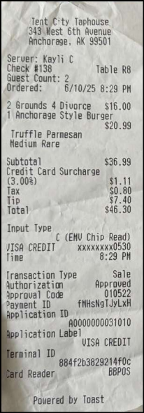
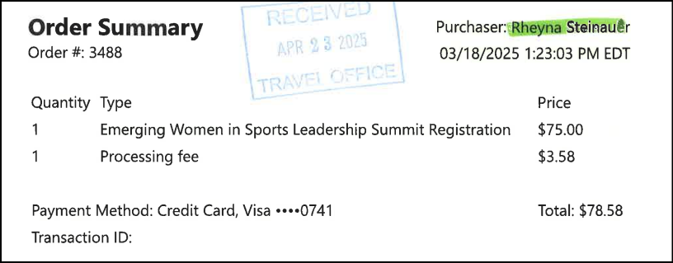
REIMBURSEMENT DOCUMENTS – CO17XP
*Avoid Reservation, Confirmation, etc. documents.
Submit: Itemized documents showing payment information.

Slide 18
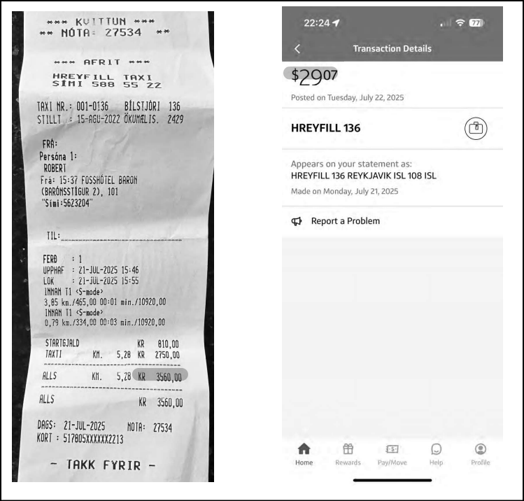
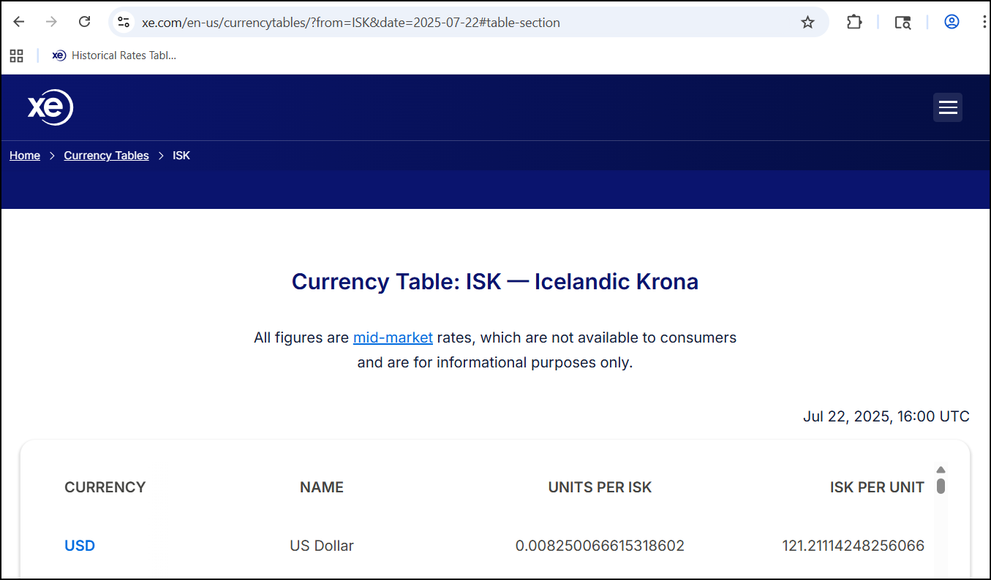
INTERNATIONAL REIMBURSEMENT DOCUMENTS CO-17XP

Slide 19
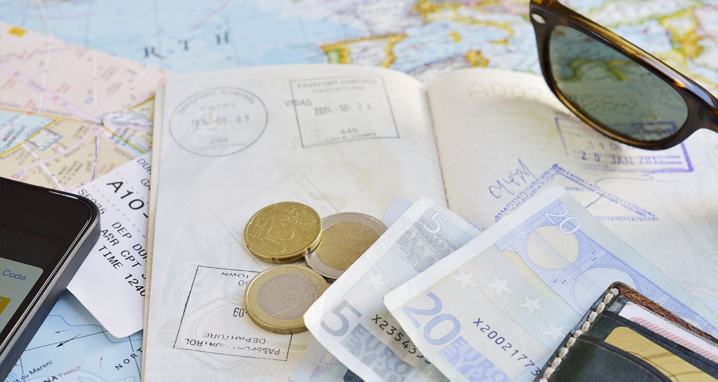
FOREIGN TRAVEL REIMBURSEMENT
All travel policies apply when traveling internationally. Travelers may be reimbursed for reasonable expenses associated with their travel such as, but not limited to:
Visa
Inoculations
Daily Currency exchange
Airport taxes
Departure taxes
Excess baggage
All receipts paid by the traveler using foreign currency must clearly indicate the foreign currency type. If the receipt does not indicate the foreign currency type, the traveler should handwrite it in.
Proof of the currency conversion rate for each receipt is required to be submitted with the travel reimbursement request. Reimbursements will not be processed without this documentation.

Slide 20
COMBINED BUSINESS & PERSONAL TIME
When combining personal pursuits with business on a trip, indicate the dates of the personal time on the Travel Authorization.
The employee will be responsible for any additional costs incurred as a result of the personal travel.
Reimbursement of expenses for personal travel is NOT allowable.
To determine the additional cost of alternate site routing, the traveler must provide a quotation of the cost of round-trip airfare directly to and from the business destination. Quotations must be from the same source on the same day that travel is booked. (e.g., travel agency, internet website) The difference between the cost of the round-trip airfare including the alternate site routing versus the cost of the round-trip airfare directly to and from the business destination constitutes the additional cost of alternate site routing.

Slide 21

Questions?

