Slide 1
Purchasing Policy Refresher
Travel, Candidate Reimbursement, Procurement & More!

Slide 2
Travel Policy
All travel must be pre-approved. Expenses that are incurred before travel is allowed are the responsibility of the traveler and will be disallowed.
Reimbursements will ONLY be processed for expenses submitted within 30 days of travel.
In-State Travel:
Approval via submission of travel authorization.
A current certificate of insurance must be on file with minimum liabilities met
Mileage only or non-mileage expenses of $50 or less does not require a TA
The actual trip.
Submit actual expenses within 30 calendar days of trip completion.
Out-of-State or Foreign Travel:
Approval via submission of travel authorization.
The actual trip.
Submit actual expenses within 30 calendar days of trip completion.
Required Documentation:
Copies of all relevant documentation must be attached.
This includes copies of the conference bulletin, or announcement showing the name, location, and inclusive of dates of the conference, registration fee, and conference hotel fee schedule.

Slide 3
Travel Policy
Airfare:
Employees should purchase the lowest commercial fare available- the least costly, coach-class fare that uses a regularly scheduled commercial carrier.
Travelers should not consider their preference for airline, type of aircraft, or connecting airports.
Travelers may not insist on non-stop flights.
Baggage fees will be reimbursed for one (1) piece of checked baggage each way.
Lodging:
Under no circumstances will lodging be paid for a guest or spouse unless they are also travelling on approved University business.
The traveler should obtain the lowest cost lodging possible. In the case of a conference, travelers are permitted to stay at the conference hotel.
Travelers can arrive one day before the event and stay one day after the event.
Lodging is not entitled when travel distance is less than 75 miles one way.
Meal Reimbursement:
Based on per diem rates.
Reductions applied when meals are provided at no cost during events.
Car Rentals:
Use approved rental agencies.
Select the most economical vehicle suitable for the trip.

Slide 4
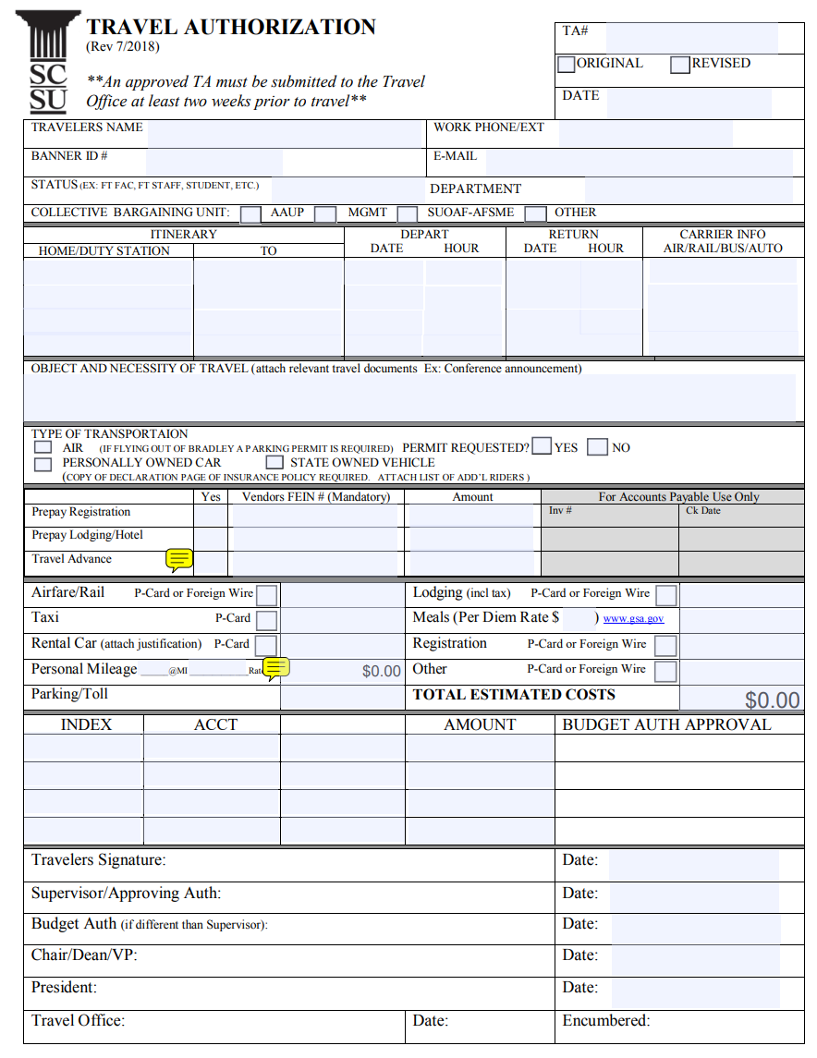
Travel Policy

Slide 5
Travel Policy
Travel Advances VS. P-Card:
Feature | Travel Advance | P-Card
Usage | Covers up to 80% of the total approved for reimbursement on the TA exclusive of pre-payments. Submit at least 2 weeks prior to travel. | Used for direct travel-related expenses
Reconciliation | Required within 30 days post-trip | Transactions must be reconciled in U.S. Bank and via the TA within 30 days post-trip
Limits | Issued for estimated travel expenses | Subject to P-Card spending limits
Preferred For | Employees without a P-Card | Airfare, lodging, registration fees, etc.
📌 Travel Questions? 📞 Contact Renee Knight ✉️ Travel@Southernct.edu

Slide 6
Reimbursement for Candidate Searches
Travel:
Limited to coach/economy class.
Only one baggage fee.
Lodging:
Single room rate.
Itemized receipts required.
Meals:
Itemized receipts required up to federal per diem rate for New Haven county.
Required Documentation:
The Chair of the search committee is responsible for the collection and submission of reimbursement for forms and receipts.
Final approval is provided by the University President.
📌 Candidate Reimbursement Questions? 📞 Contact Accounts Payable ✉️ AccountsPayable@Southernct.edu

Slide 7
Reimbursement for Out-of-Pocket
Expenses Less Than $100
Purchases for official SCSU purposes only.
Reimbursement Process:
Employee Voucher- Travel and Other- For expenses incurred in Connecticut (CO-17XP).
Original receipts required.
Must submit within 30 days of purchase.
Excluded purchases include:
Air conditioners/Space Heaters
Advertising
Business Cards
Flowers or gifts for SCSU Employees/Relatives
Refreshments
Only expenses under $100 that are pre-approved and within the scope of allowable items will be reimbursed, regardless of funding source.
📌 Reimbursement Questions? 📞 Contact Accounts Payable ✉️ AccountsPayable@Southernct.edu

Slide 8
Gift Card Purchases
Only P-Card Administrators can purchase Gift Cards.
CSCU is currently creating a Gift Card Policy.
Departments must submit a Gift Card Request Application
Requires Vice President or Dean approval.
Distribution and Documentation
Departments must submit and maintain a Gift Card Distribution Log.
Unused gift cards must be returned within 30 days.
Subject to audit and state record retention policies.
Tax Reporting
Employees: Always taxable & reported on W-2.
Non-Employees: Reportable on Form 1099- MISC if over $600.
Security & Compliance
Stores all gift cards in a secure, locked location.
Maintain and inventory log & report discrepancies to Nina Cote.
Non-compliance may result in disciplinary action or loss of privileges.
📌 Gift Card Questions? 📞 Contact Procurement ✉️ Procurement@Southernct.edu

Slide 9
Amazon Business
All purchases must adhere to the University’s Procurement Guidelines.
Purchases made through personal accounts will not be reimbursed.
At this time, only P-Card holders can access Amazon Business accounts.
📌 Amazon Questions? 📞 Contact Kwadir Delgado-McIntyre ✉️ DelgadoMcik1@Southernct.edu
Staples
All purchases must adhere to the University’s Procurement Guidelines.
All purchases must be approved by the budget authority of the org.
Available to all University employees.
📌 Staples Questions? 📞 Contact Richard Glasson ✉️ GlassonR1@Southernct.edu

Slide 10
Procurement
Generally Accepted Purchasing Principles:
All procurement activities must be conducted ethically, avoiding conflicts of interest.
Processes should be open and transparent to maintain public trust.
Aim to procure quality goods and services at the best possible value.
Purchase Requests and Sourcing:
Procurement processes begin with a detailed purchase requisition outlining the required goods or services.
Depending on the procurement’s value and nature, methods include competitive bidding, requests for proposals, and utilization of existing state contracts.
Per Connecticut Statute CGS 4-56 state funds cannot be used to purchase alcoholic beverages unless authorized by specific law or if the purchase is necessary for a state event or function where alcohol is served as part of the event.
📌 Procurement Questions? 📞 Contact Procurement ✉️ Procurement@Southernct.edu

Slide 11
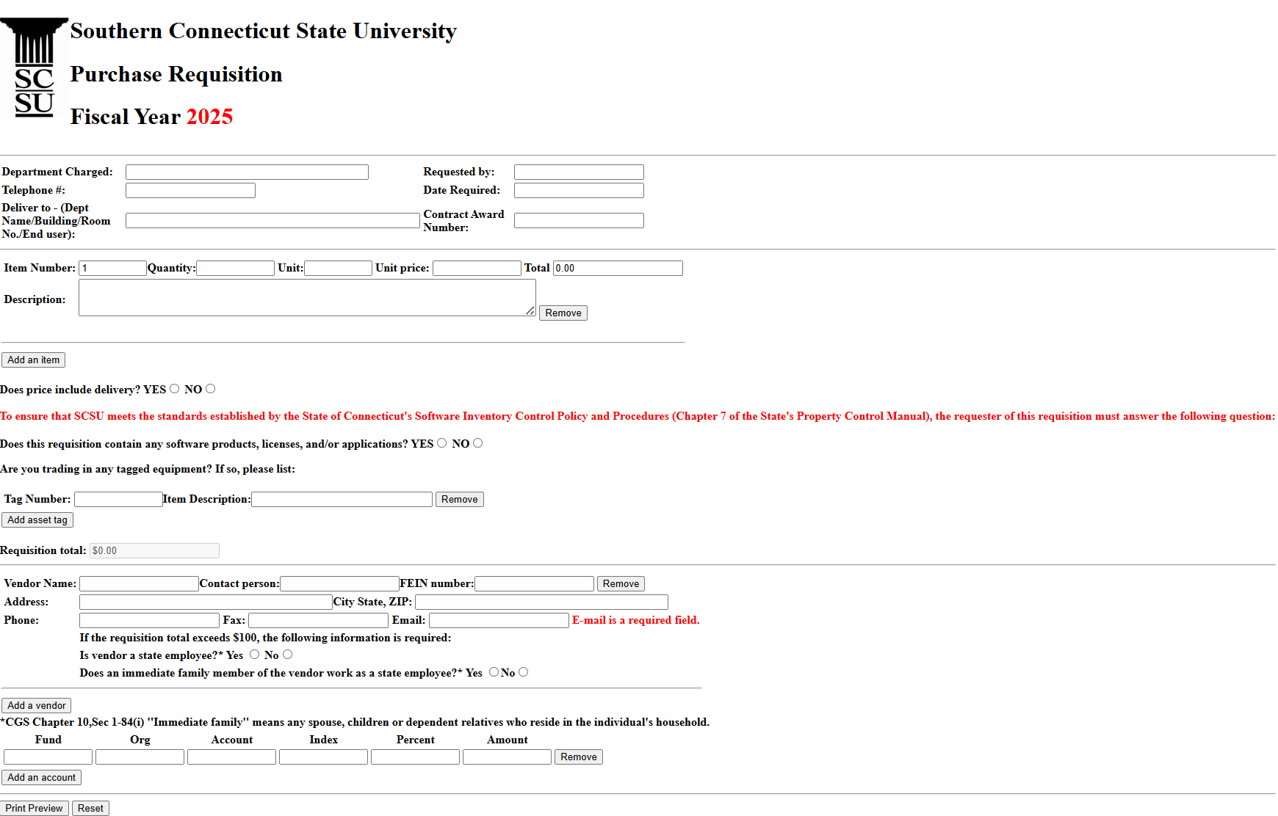
Procurement

Slide 12
Contracts
Vendor Awards:
Vendors are evaluated based on factors such as price, quality, delivery capabilities, and compliance with CSCU standards.
Contracts are awarded to vendors that best meet the established criteria and offer optimal value.
Methods of Contracting:
Contracts- Formal agreements used for complex procurements or ongoing services. Contract review takes 2-4 weeks at SCSU. Please plan purchases accordingly.
State Purchasing Thresholds:
Competitive bidding may be waived for minor, nonrecurring purchases up to a maximum of $25,000.
Goods and services procurements estimated to exceed $25,000 up to a maximum of $100,000 shall be made in the open market, and be based on three competitive quotes. AG must approve contracts of $25,000+.
Goods and services procurements estimated to exceed $100,000 over the life of the contract, must be advertised online on the State Contracting Portal for a minimum of five days. AG must approve contracts of $25,000+.
Only the President or Vice Presidents can sign contracts on behalf of the University.
All contracts should be on AG approved templates.
📌 Contract Questions? 📞 Contact Nina Cote ✉️ CoteN1@Southernct.edu

Slide 13
Thank You!

