Slide 1
Sociology internship Orientation
2019-2020

Slide 2
Course description
SOC 497—Sociology Internship The internship is a basis for performing sociological research. Work assignment to a governmental or private agency and a related research project explicitly grounded in sociology. Joint supervision by agency representative and departmental faculty. Prerequisites: departmental permission, plus SOC 255 (FORMERLY 370) and 260 (FORMERLY 380). 3 credits.

Slide 3
Purpose & Learning Goals/ Outcomes of internship
Purpose
3 credit internships fulfill the Sociology program capstone requirement for both B.A. Sociology and B.S Sociology with Criminology concentration.
Internships provide students with an opportunity to make connections between their academic study in sociology/ criminology and potential career paths.
Learning Goals/Outcomes
Conduct sociological analysis of internship experience.
Explore career opportunities related to professional goals.
Develop/ enhance/ demonstrate marketable career skills (e.g. professional writing, collaboration, data management/ analysis, oral presentation, etc…)

Slide 4
CONVERSION - CREDIT HOURS/INTERNSHIP HOURS
A three-semester hour internship fulfills the required capstone for the major. Additional hours may be taken in Sociology Electives and/or Free Electives. Discuss these options with your academic advisor.
3 semester credit hours = 135 hours on site (equivalent to 10 hours per week for 15 weeks)
You may complete up to two unique internships (6 credits) prior to graduation for both BA-SOC & BA-SOC/CRIM majors
6 semester credit hours = 270 hours on site (equivalent to 20 hours per week for 15 weeks)
For feasibility, 6 cr internships are typically spread over 2 semesters – 135 hours/ semester

Slide 5
Internship STUDENT Steps
Attend the Internship Orientation session in term prior to desired internship.
Select a SOC faculty member to serve as your academic internship advisor.
Identify appropriate internship sites.
Contact internship sites and complete their application process. Note that some sites require extensive background checks – begin early!
Secure a written confirmation of acceptance at internship site as well as a list of tasks/ duties for the internship.
Complete the A&S internship application form. See: https://www.southernct.edu/academics/schools/arts/files/documents/internshipform_AS.pdf
Write internship proposal essay and attach to A&S internship application form.
Submit A&S internship application
A&S Internship Form
Internship Proposal Essay
Internship Site Confirmation of Position signed letter
Internship Site List of Tasks/ Duties

Slide 6
INTERNSHIP APPLICATION FLOW
Secure Internship Site Offer
Submit Internship Application to Sociology Department for SOC approval
SOC submits approved Internship Application to A&S
A&S approves/ denies Internship
Student receives approval & registers for SOC 497
Identify Faculty Internship Advisor

Slide 7
Internship Requirements
Internship may not commence until:
student is officially registered for the course *AND*
the semester officially begins
Meet with Faculty Advisor in first week of semester to identify appropriate meeting schedule and academic deadlines for assigned coursework/ tasks.
Complete required hours at the internship site:
135 hours (3 credit) + portfolio
270 hours (6 credit) + portfolio
Complete and submit the following to your Internship Faculty Advisor
All assigned academic requirements and tasks by assigned deadlines
Internship Hourly Log (signed by internship site supervisor)
Internship Student Evaluation
Internship Site Supervisor Evaluation (signed letter in a sealed/signed envelope)

Slide 8
Internship faculty advisor
Students must secure a faculty advisor who will oversee their internship. Below is a list of eligible faculty and their areas of research/ teaching interest. Note: Only SOC full-time faculty may serve in this role.
Dr. Gregory Adams (criminology/deviance, drug policy, statistics)
Dr. Jessica Kenty-Drane (social inequality, childhood studies, education, statistics)
Dr. Cassi Meyerhoffer (race & ethnicity, residential segregation, urban sociology, qualitative methods)
Dr. Catherine Tan (medical sociology, science & technology, qualitative methods)
Dr. Janani Umamaheswar (criminology, gender, qualitative methods)

Slide 9
Suggested internship sites:
Law enforcement agencies (e.g. police departments, Connecticut Judicial Branch (probation), DoC (parole), juvenile detention centers, DCF, district courts)
State agencies (e.g. Department of Children & Family services, Division of Criminal Justice, Emergency Management & Homeland Security)
Educational Organizations (e.g. public/ private k-12 schools, alternative education programs, adult education programs, literacy programs, ESL programs, tutoring/ mentoring programs)
Non-profit organizations (e.g. soup kitchen, homeless shelter, domestic violence organizations/ shelters, immigrant services, halfway home, alcohol/ drug addiction programs, alternative education program)
For-profit organizations (e.g. research/ consulting firms, law office, marketing/advertising firms, human resource departments)

Slide 10
How to find an internship
Identify your personal, academic and professional goals for your internship (e.g. skills, certifications, credentials, graduate program requirements, etc…).
Consult with your peers, internship faculty advisor and other faculty for potential internship sites ideas.
Conduct a web search for potential internship sites using these relevant websites/ search engines/ documents:
Idealist.org: http://www.idealist.org/
New Haven area non profit groups: http://givegreater.guidestar.org/ (go to FIND/ View all nonprofits)
State of CT non profit groups: http://www.ct.gov/csec/site/default.asp (go to Forms/ Charity Directory)
Indeed.com: http://www.indeed.com/ (Search: Sociology *or* Criminal Justice)
State of Connecticut State Agencies: http://portal.ct.gov/Department-and-Agencies/

Slide 11
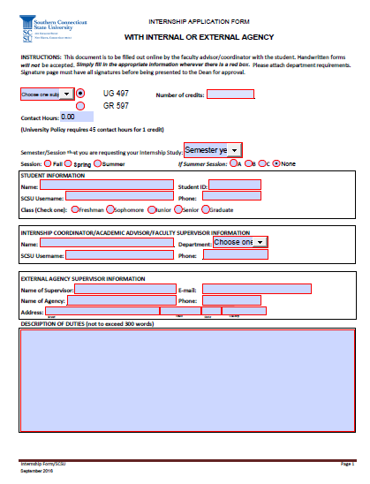
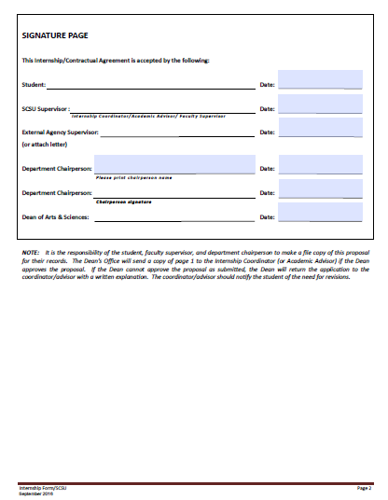
A&S Application form: click here

Slide 12
Internship application essay
Summary and explanation of internship site
Relationship to your career path & sociology
Identify the organization, division within the organization, the organization’s purpose/goal.
Present a summary of the internship duties you will be expected to perform.
Explain why you selected this internship site.
Describe the internship’s relevance to your personal and professional goals.
Describe the internship’s relevance to the discipline of sociology.

Slide 13
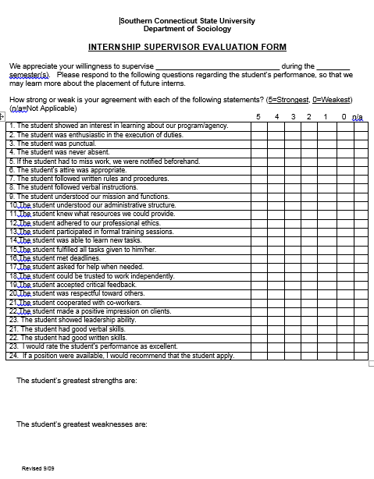
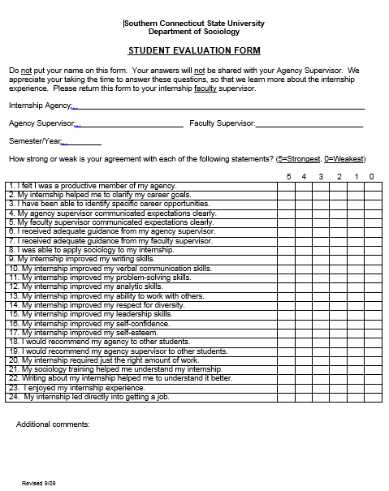
Evaluation forms

Slide 14
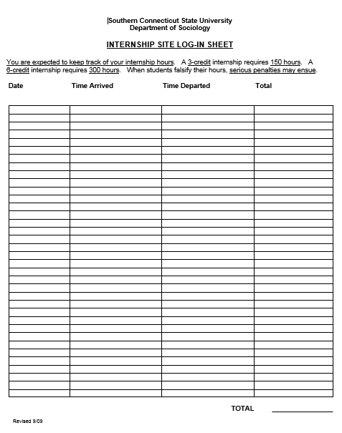
Internship hourly log

Slide 15
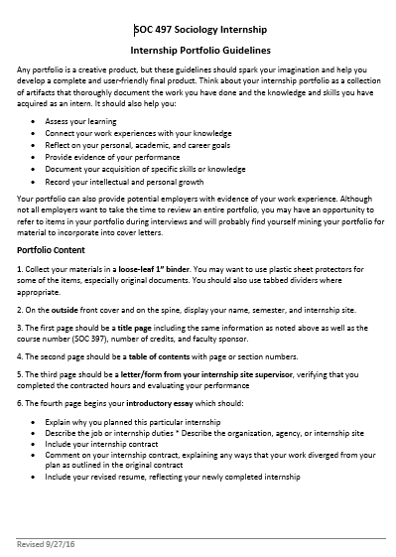
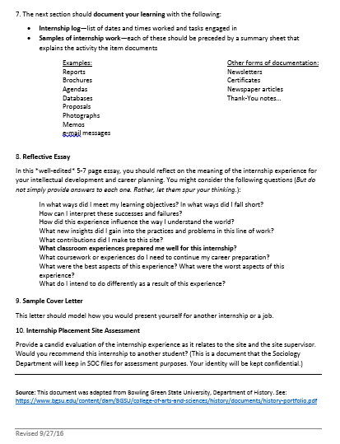
Example: academic outcome - portfolio

