Slide 1
Sociology Group Advising Workshop
Covid-19 edition
SPRING 2021

Slide 2
Workshop Housekeeping
Please MUTE yourself when not speaking.
If you experience disruption in your feed, please try turning off your VIDEO.
Please use the CHAT feature to ask questions as we go through the slides. Our moderator will relay all questions.
If you wish to speak, please use the RAISE YOUR HAND feature.
Find your name on the participant list, and hover over your name. A Raise Hand icon will appear.
Any concerns or questions you have after today’s session may be directed to your assigned academic advisor *or* emailed to the Sociology Department.
These slides will be posted online on our Inside Sociology page.

Slide 3
Registration Workshop Overview
Welcome! Meet your faculty!
COVID-19 Campus Resources
Pin is required for Registration. You will receive instructions on how to access your PIN via email after you attend your advising session.
How to get advised: program information, advisor contact information, advising worksheet
How to access & read new degree evaluation
How to access SSC Navigation for advising notes
Opportunities in Sociology: Careers, Graduate School & Student Involvement

Slide 4
Registration schedule (BASED ON COMPLETED CREDITS)
SPRING 2021 REGISTRATION
(pin required)
Seniors * (90 credits +): April 6
Juniors (60-89 credits): April 12
Sophomores (30-59 credits): April 14
First Year Students (<30 credits): April 19
*Athletes register with seniors.
SUMMER 2021 REGISTRATION
Begins March 20. (no pin required)
WINTER 2021-22 REGISTRATION
Tba (no pin required)
INSTRUCTIONS FOR REGISTRATION
Notes:
1) Registration schedule is based on COMPLETED credits. View your transcript for your completed credits. Your degree evaluation includes in-progress coursework in your total credit count, *unless* you UN-select in-progress coursework.
2) Registration for SOC 497 Internship, SOC 499 Independent Study, HON 494/ HON 495 Honors Thesis Proposal/ Honors Thesis, or graduate coursework must be done with permission of your faculty advisor, department chair and academic dean. Please be sure to allow adequate time to prepare your application for the aforementioned coursework.
Notes:
See: https://inside.southernct.edu/onestop/registration/dateandtime

Slide 5
Sociology & soc-criminology 2020-2021 advising model
Student Resources
Undergraduate Academic Advising
Review your Degree Evaluation; Perform What If? Analysis to explore new majors and minors
Review all notes posted in SSC-Navigate
Review online course schedule
Use search tools to identify LEP/ W courses
Department of Sociology Resources
Group Advising (offered each semester)
Internship Orientation Session (offered each semester)
One-on-One advising for all majors (Available as needed). Please see Faculty Advisor Contact handout for current appointment booking process.
University Resources
Advising Resources: Degree evaluation, GPA Tool, Academic Maps, Major Elimination Tool
Professional Academic Advisor: Assistant Director of Academic Advising for Social and Behavioral Sciences, Widelyn Dorelus moisew1@southernct.edu (x2-6747)
Academic warning/ probation
Switching majors
Financial & Housing concerns
Personal & family-related academic disruptions
Academic Success Center (BU 303) offers Academic Success Coaching
Counseling Services (EN B219)
Notes:
Online Course Schedule link: https://ssb-prod.ec.southernct.edu/pls/cs/byskcsob.P_TermSel

Slide 6
Advising Appointment Options
Course Registration Advisement:
All students should attend an online advising session to secure general advising information. See your email for invitation weblink. You may also arrange optional one-on-one course registration/ degree planning advising by contacting your assigned faculty advisor denoted on your Degree Evaluation. See Inside Sociology for important faculty contact information.
Academic & Professional Advisement:
You may always schedule an appointment with your adviser to discuss academic and professional interests. It is easiest to make these appointments outside of the registration period.

Slide 7
Sociology Bachelors’ Programs
Bachelor of Science Degree with a Criminology Concentration (36 credits)
Bachelor of Arts Degree in Sociology (36 credits)
BS & BA CORE REQUIREMENTS (18 Credits)
Note: You must earn a “C” or better in all CORE courses.
SOC 100 – Introduction to Sociology
SOC 201 – Social Science Statistics
SOC 255 – Research Methods in Sociology
SOC 260 – Applied Contemporary Theory
Diversity Requirement (choose one):
SOC 310 - Racial and Ethnic Relations
SOC 315 – Sociology of Gender or
SOC 363 – Social Inequality
In addition, students complete their major with a final capstone requirement (choose one):
SOC 490 – Senior Seminar in Sociology (W course)
HON 494 & HON 495 – Honors Thesis in Sociology
Eligibility: 3.0 cumulative GPA & 3.2 major GPA
SOC 497 – Internship (3 cr. 135 hours unpaid)
ELECTIVE REQUIREMENTS (18 credits)
BS in Sociology with Criminology Concentration (18 credits)
SOC 362 – Criminological Theory
Five criminology and criminal justice courses. With the permission of the Department Chair, BS students may substitute related courses outside of the department, such as Crime Scene Investigation, when available.
BA in Sociology (18 additional credits)
BA students select six additional courses in sociology.
BA students may take sociology courses within criminology concentration, however these courses are limited to sociology,
Program links for more information:
BA in Sociology & BS - Soc/Crim
Notes:
Advise students to review their handout outlining their degree requirements.
All students must complete 120 credits to earn a bachelor’s degree. The SOC major will account for 36 of those 120 credits.
B.S. & B.A. share core requirements (18 credits, must earn C or better)
Sociology/ Criminology capstone courses does not fulfill the LEP Tier 3 capstone!
The term “elective requirement” may sound like a contradiction in terms, but this is where students get to explore courses that focus on their interests.

Slide 8
Accelerated pathway: ba/bs to ms sociology program
Overview: These programs are designed to provide high-achieving undergraduate students with the opportunity to complete foundational graduate coursework during their senior year in order to accelerate graduate degree completion.
Coursework (30 credits: 6 CR while undergrad senior)
Senior Fall: SOC 500 Sociology & Social Justice (3cr)
Senior Spring: SOC 580 Theories of Social Justice (3 cr)
Graduate Summer: Elective (3cr)
Graduate Fall: SOC 570 Methods of Social Research,
Elective, Elective (9 cr)
Graduate Spring: Elective, Elective, Elective (9 cr)
Graduate Summer: Elective (3cr)
Capstone: Capstone requirement must be met within the above 30 credits. Capstone options include: Special Project, Thesis or comprehensive examination.
Admissions Standards:
3.0 cumulative and major GPA by start of spring semester in junior year
Admissions Steps:
Declare accelerated pathway in major declaration tool in Banner prior to spring of junior year.
Submit application for accelerated pathway by March 1st of junior year (contact Graduate Coordinator for application)
Accepted students register for graduate coursework in fall/spring of senior year
Apply to M.S. Sociology program in spring of Senior year.
Accepted students register for summer and fall coursework.

Slide 9
Planning for next semester: Q1: What Tier 1 courses remain?
LEP Tier-1 Courses |  | Code
 | First Year Experience- Inquiry 101 | T1FY
 | Critical Thinking | T1CT
 | Multilingual Communication: 200 course for any language (Note: 100 & 101 prerequisite coursework may be necessary) | T1MC
 | Quantitative Reasoning (MAT 103, MAT 107…) Sociology majors are encouraged to take: MAT 107 Elementary Statistics | T1QR
 | Written Communication – ENG 112 or 120 (for bilingual students) | T1WC
 | Technological Fluency | T1TF
Notes:
Tier 1 Quantitative Reasoning – Sociology recommends MAT 107 Elementary Statistics.

Slide 10
Q2: What Tier 2 Courses remain?
LEP Tier-2 Course |  | Code
 | Natural World 1 – Physical Realm | T2PR
 | Natural World 2 – Life & Environment | T2LE
 | SIX (6) of the following:
 | Cultural Expression | T2CE
 | Global Awareness | T2GA
 | Mind and Body | T2MB
 | American Experience | T2AE
 | Creative Expression | T2CD
 | Social Structure, Conflict and Consensus | T2SS
 | Time and Place | T2TP
Notes:
Popular Science Coursework for SOC-CRIM Majors:
TIER 2: Natural World I: Physical Realm: CHE 103 Crime Scene Chemistry
TIER 2: Natural World II: Life and Environment: ANT 102 Biological Anthropology

Slide 11
Q3: Which Tier 3 Course to take?
Sociology and Sociology-Criminology majors are not restricted within Tier 3. You may select any course for which you meet the prerequisites.
Students often select a course that simultaneously fulfills a “W” or writing intensive course requirement.
Notes:
Prerequisite: Completion of at least 6 Tier 2 requirements and prior or concurrent completion of all Tier 1 requirements.
Note: SOC 394 is not presently offered. Please complete any other course.

Slide 12
Important LEP & LEP Timing Info:
Tier 1: Plan for prerequisites for Tier 1 coursework in Math & Language.
Tier 2: No more than two courses per subject area may be used to satisfy Tier-2 requirements.
Tier 3: You can take the capstone course when all Tier 1 courses are completed and 6 out of 8 Tier 2 courses are completed.
You may have choices as to which semester, but keep an eye on the availability of Tier-3 courses that interest you.
LEP/Major Sharing Policy
(Effective Fall 2020)
Students with a catalog term of F20 and beyond, may share up to 3 courses from the LEP with their major.
Returning students who would benefit from the new policy and would like to take advantage of it, must request a change in their Catalog term through their Chair.
Please note that there may be other consequences of a change in catalog term.
Notes:
Sharing Policy Notes: This means that courses that are found in both locations can count as such and students who elect to take a major course in the LEP do not have to take a replacement for that course within the major.

Slide 13
Writing Intensive Courses
Focus on developing writing and revising skills beyond ENG 112/120
W courses are designated as “W” by the section (e.g. SOC 320 Sec. 01W). Be sure to select “W” sections of courses you wish to take!
W courses “double dip”
Many W course sections are offered in Tier 2 areas of knowledge courses
We often offer “W” SOC electives; though NONE in CRIM elective coursework at the moment
Senior seminar (SOC 490) is always offered as a W course.
You will likely need to find one course outside of Sociology for your 3rd W-course
Notes:
Courses with a LOT of writing versus Writing Intensive courses: courses must have a “W” designation to count toward the requirement; This means course includes significant revision in the writing assignments and faculty writing instruction.
Note: Courses are denoted as “W” in their section code (e.g. SOC 320.01W). You may find a courses is offered as a “W’ in spring 2020, but not as a “W” in Fall 2020. You may find “W” sections of courses listed with non-”W” sections of the same course on the spring/ fall schedule. Be sure to select “W” section!!!

Slide 14
University elective coursework
All students must earn 120 credits total. This means you will have an opportunity to take university electives.
Use electives to:
Earn Cooperative Education (COOP) credits
Independent study
Complete minors!
Study abroad! (Limited due to COVID-19)
Prepare for graduate education, medical school (pre-med courses) or law school (pre-law courses).
Improve your GPA (2.0 CUMULATIVE GPA REQUIRED)
Transfer students may have a significant number of elective coursework completed upon transfer. Please review your credit count to identify how many elective courses you are expected to complete to finish your SCSU degree!
Notes:
Information on Cooperative education, independent study, study abroad, etc…: https://catalog.southernct.edu/undergraduate/general-information/part-time-and-alternative-study.html

Slide 15
Remember!
Credit Minimum
All students must earn 120 credits and complete all degree requirements in order to graduate:
LEP + MAJOR + ELECTIVE CREDITS = 120 CREDITS
Please note that the Degree Evaluation credit count *includes*: earned credit + credits to be earned in the current term!
LEP
The specific courses that fulfill Tier 1, Tier 2 and Tier 3 Capstone courses are listed under each requirement on your degree evaluation.
Be sure to use a current degree evaluation so you have the most updated list to select from.
If you have questions about LEP, particularly how non-Sociology transfer credits might apply to the LEP, you should review the website or contact the LEP Director (EN B115) at transfer@southernct.edu.
TRANSFER CREDITS
Review your Transfer Credit Worksheet posted on Notes in SSC Navigate (should be your first note).
Use the Transfer Equivalency Website to identify how coursework will transfer to SCSU.
Contact LEP Director re: questions about LEP Transfer: transfer@southernct.edu.
Sociology Department chair determines applicability of transferred coursework to the BA/ BS majors.
Any non-Sociology coursework transferred in will be applied according to the academic chair of the course discipline or the LEP director (Located in EN B115).
Notes:
LEP Website:
https://inside.southernct.edu/lep
Transfer Equivalency Website:
https://ssb-prod.ec.southernct.edu/PROD/scsu_transfer.p_student_request

Slide 16
Advising Worksheet for (name): __________________________ [Print, complete, & bring with your degree evaluation to your appointment]
Possible Courses for next Semester
Student ID _________________
Questions for Advising
______________________________ Student signature

Slide 17
Typical Sophomore Year Schedule: Most of these courses reflect selected options.
Fall
1 | SOC 201 | Social Science Statistics (Core Req)
2 | SOC 255 | Research Methods (Core Req)
3 | SOC 310 | Ethnic and Racial Relations (Core)
4 | SOC 265 | Self and Society (Tier-2 MB)
5 | SPA 200 | Spanish III (Tier-1, Multi-lingual Comm)
Spring
1 | SOC 260 | Applied Social Theory
2 | SOC 250 | Apocalypse Now?
3 | SOC 362 | Criminology
4 | PSC 260 | US Government (Tier-2 AE)
5 | CHE 103 | Crime Scene Chemistry (Tier-2 Nat World 1)

Slide 18
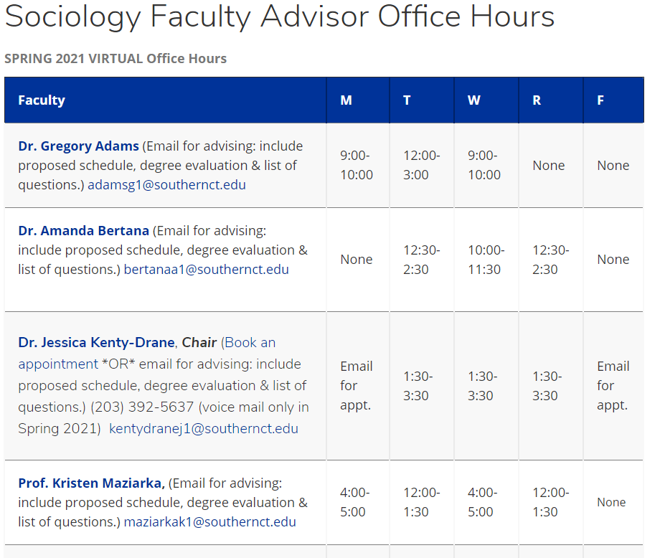
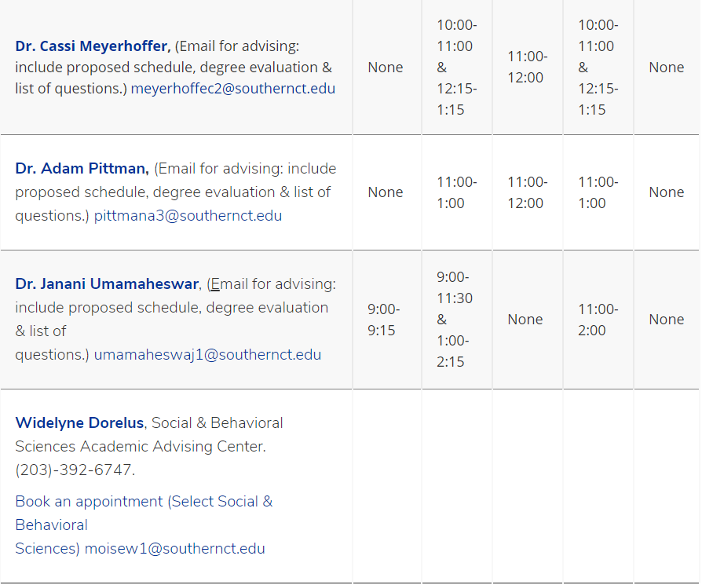
faculty advisor contact INFORMATION
Notes:
See: https://inside.southernct.edu/sociology/faculty

Slide 19
Sociology Careers: What can I do with a Sociology major?
Social Services: Including case work and social work. In fact, sociology is good preparation for those interested in going to graduate school in social work (MSW) and, of course, in sociology.
Public Services: Not all public services require a degree. Increasingly, however, even police departments show significant preference that officers earn an undergraduate degree before applying for law enforcement positions. Our Bachelor of Science in Sociology with a Criminology Concentration is extremely popular, but not required, for those entering law enforcement.
Management: Students seeking research and writing skills in our programs may be well prepared for entry level management positions, especially if they focus on data analysis and good communication skills.
Education: Teaching K-12 in Connecticut requires certification, but this is not the only option for those interested in education. Moreover, a sociology degree is good preparation for those hoping to earn their certification while pursuing a Master of Education degree (M.Ed)
Marketing: Marketing uses the predictive elements of social research to predict outcomes that can be profitable in business.
Social Science Research: Those who pursue advanced training in the social sciences will find that their degree in sociology provided the proper foundation

Slide 20
Career & Professional Development
Career information and support services can be found online at Career & Professional Development. Their services include resume and cover letter writing, interview prep, mock interviews, and virtual career fairs.

Slide 21
Sociology students - get involved!
Join a club!
Sociology Club (Contact Professor Maziarka) – Review emails for updates.
Alpha Kappa Delta, Sociology Honors Society (cumulative GPA 3.30 +), Contact Professor Maziarka for information/ application.
Engage in student research!
Independent Study (SOC 499)
Honors Thesis (HON 494/ HON 495)
Undergraduate Research Conference (See email/ website for call for presentations.)
Get involved in the community!
COOP (employment for credit)
Internship (SOC 497)
Coordinate or participate in a community event (Recruit your classmates! Contact department.)

Slide 22
2021 scsu event: Un sustainable development goals
Foundation for Environmental Stewardship (FES) is a youth-led, youth-serving sustainable development organization. They are partnering with SCSU to educate students and community partners about the UN Sustainable Development Goals and to invite everyone to consider how to spread the word and reimagine our communities.
Three day credentialing event: April 8, 9 & 10
April 8th view an asynchronous online video
April 9th listen to UN official discuss the UN Sustainable Goals & ask questions 1-2 p.m.
April 10th design and network with local community partners around UN Sustainable Development Goals
Students will receive certificate upon completion of the program
More Information & Registration: https://www.sdgslaunch.com/scu
Contact Dr. Bertana with any questions! bertanaa1@southernct.edu

Slide 23
Graduate School
Graduate Studies
High achieving students interested in advanced study will find they are well prepared for masters programs in sociology and other fields.
Highest achieving students will find they are competitive for entry into well funded combination MA/PhD programs
A bachelor’s degree in sociology does not limit you to sociology for graduate studies
Students interested in providing counseling and psychotherapy services most often pursue MSW programs (Master of Social work) and sociology graduates are often successful on this career path
SCSU offers an M.S. in Sociology, with emphasis on Social Justice. Contact the Gradutae Coordinator for more information.
SCSU School of Graduate Studies: Attend Online Graduate Open House each Fall or Spring!

Slide 24
Internship Steps:
Prerequisites Include: Successful completion of SOC 255 & SOC 260.
Attend the Internship Orientation session in term prior to desired internship. Check Email for date.
Ask a SOC faculty member to serve as your academic internship advisor.
Identify appropriate internship sites.
Contact internship sites and complete their application process. Note that some sites require extensive background checks – begin early!
Secure a written confirmation of acceptance at internship site as well as a list of tasks/ duties for the internship.
Complete Arts & Science (A&S) internship application form
Write internship proposal essay and attach to internship application form.
Submit internship application
A&S Internship Form
Internship Proposal Essay
Internship Site Confirmation of Position (i.e. signed letter or email to faculty advisor)
Internship Site List of Tasks/ Duties

Slide 25
Notes:
Please contact your Faculty Advisor with any questions or concerns. Your assigned faculty advisor is listed on your current degree evaluation.

