Slide 1

Accounts Payable
Fundamentals
Vanessa Spence

Slide 2



Agenda
Differentiate Between Departments
Requests for Payment
Payment Verification
Q & A

Slide 3

Procurement Department Overview
What is Procurement Responsible For?
Contracts
PSA’s
Purchase Requisitions/Purchase Orders
What Information Should I Provide to the Procurement Department?
Invoice or Quote/Estimate
W-9 Form
Supporting Documentation for Contracts & PSA’s
📌 Procurement Questions? 📞 Contact Procurement ✉️ Procurement@Southernct.edu
📌 Escalated Issue? 📞 Contact Tim Krauss and Nina Cote
Notes:
Image source: Microsoft 365 content library The Procurement Department manages contracts, purchase requisitions, purchase orders, invoices, quotes, W9 forms, and supporting documentation such as personal service agreements. For requisitions and general purchase order inquiries, contact Procurement@southernct.edu. Escalations should be directed to Tim Krauss or Nina Cote for prompt assistance.

Slide 4

Accounts Payable Department Overview
What is Accounts Payable Responsible For?
Payment after services are rendered or goods are received
Travel
What Information Should I Provide to the Accounts Payable Department?
Approved/Signed Invoices
Employee Voucher (CO-17XP)
Reimbursement for out-of-pocket expenses $100 or less
Travel*
Candidate Reimbursement Form
Voucher/Disbursement Form
ACH Enrollment Form
Stop Payment Requests
W-9’s and W-8’s
📌Accounts Payable Questions? 📞 Contact Accounts Payable ✉️ AccountsPayable@Southernct.edu or Travel@Southernct.edu*
📌 Escalated Issue? 📞 Contact Dale Bodyk
Notes:
Image source: Microsoft 365 content library The Procurement Department manages contracts, purchase requisitions, purchase orders, invoices, quotes, W9 forms, and supporting documentation such as personal service agreements. For requisitions and general purchase order inquiries, contact Procurement@southernct.edu. Escalations should be directed to Tim Krauss or Nina Cote for prompt assistance.

Slide 5

Accounts Payable Department Overview
What Helps Accounts Payable Process Faster?
Include all required information in your initial email
Send status requests only after confirming no payment has been made in Banner
Payment Processing
AP processes checks on Wednesdays
Checks are delivered to mail services the next business day
Mail services delivers to the USPS at approximately 2:30PM
⚠️Important
Checks cannot be picked up from the AP Office
We encourage the use of Direct Deposit for faster payment!
Notes:
Image source: Microsoft 365 content library The Procurement Department manages contracts, purchase requisitions, purchase orders, invoices, quotes, W9 forms, and supporting documentation such as personal service agreements. For requisitions and general purchase order inquiries, contact Procurement@southernct.edu. Escalations should be directed to Tim Krauss or Nina Cote for prompt assistance.

Slide 6




Understanding the Payment Process
Where are the funds coming from?
Does the amount owed match the amount encumbered?
When is Payment Due?
Purchase Order
Personal Service Agreement
Direct Pay – Index AND Account Code
Due Date
Max 2 weeks after request
Possible delays:
Missing information
Issues with documentation or approvals
Payments must align with the PO balance
Overcharges only allowed if less than $100 AND within 10% of the PO

Slide 7
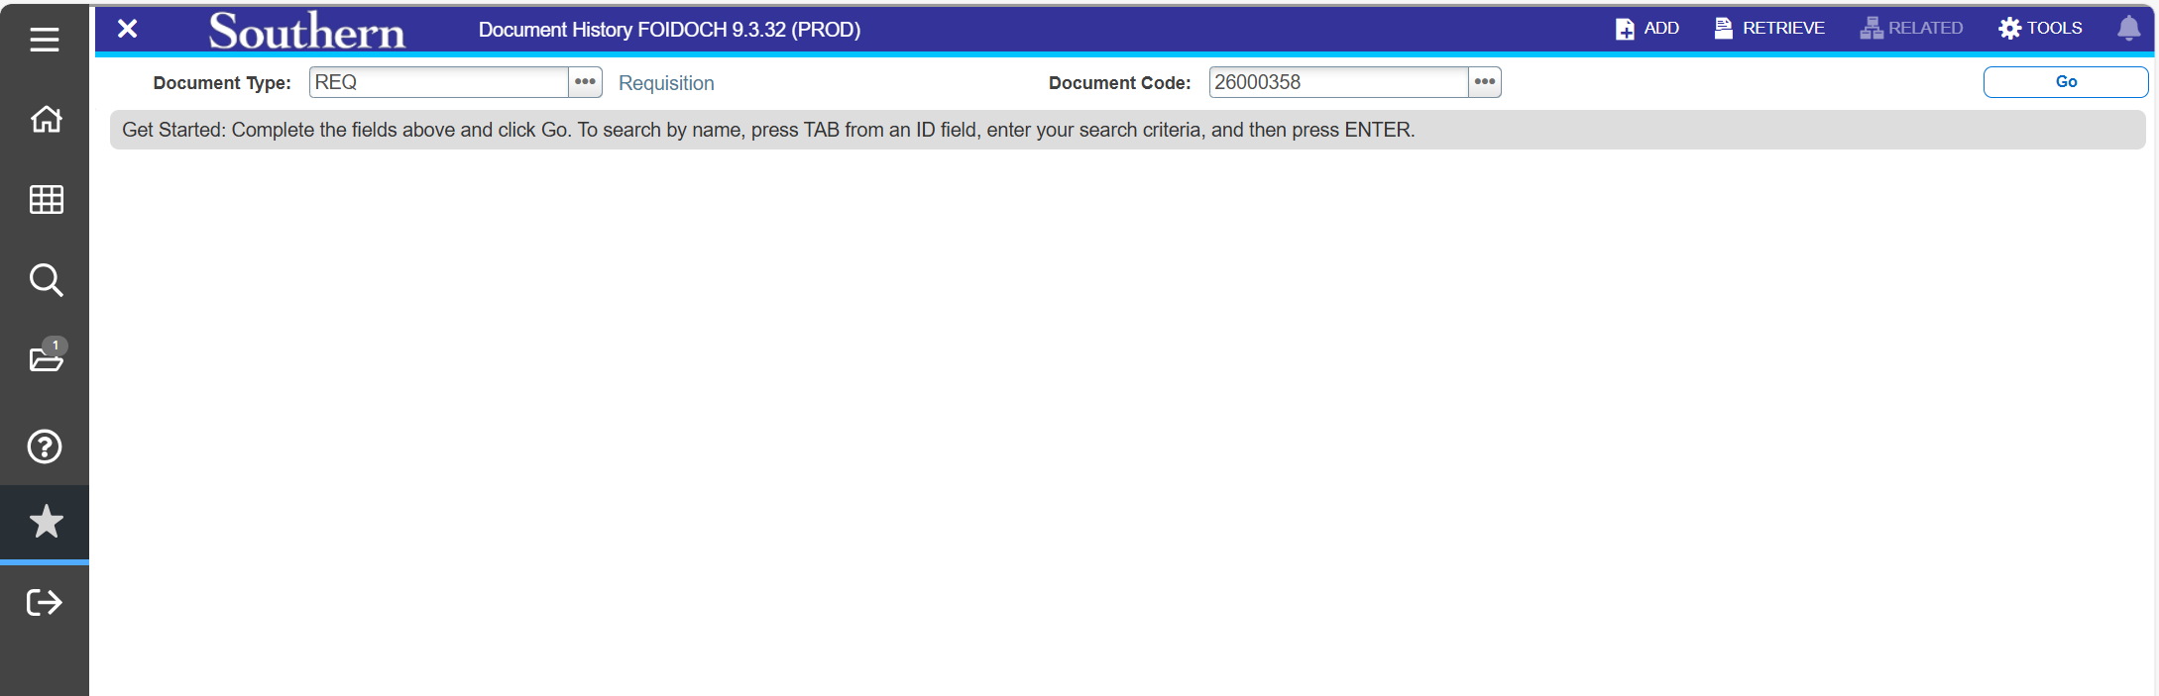
Payment Verification Document History (FOIDOCH)
Here You Will Be Able To:
Confirm if the requisition has been processed
Locate the Purchase Order Number

Slide 8
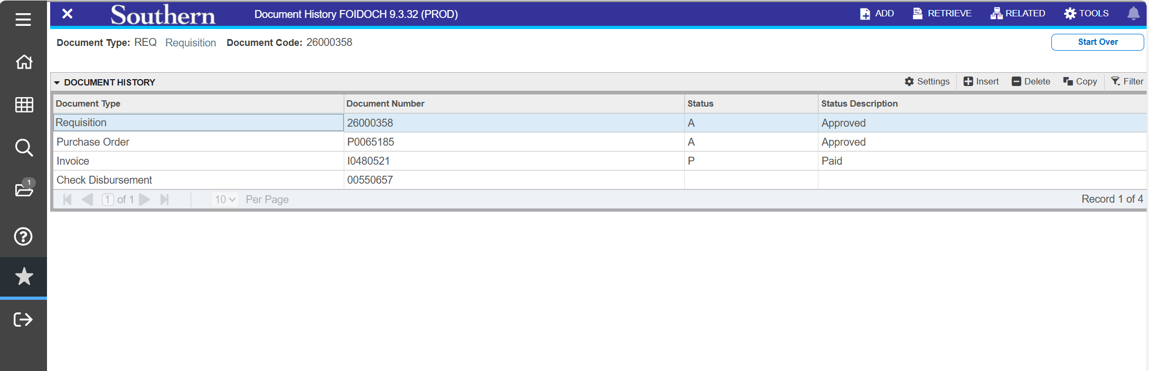

Slide 9
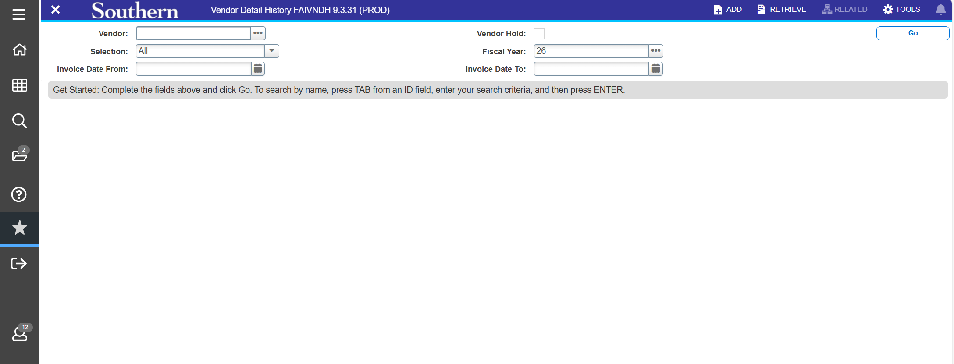
Vendor Detail History (FAIVNDH)

Slide 10
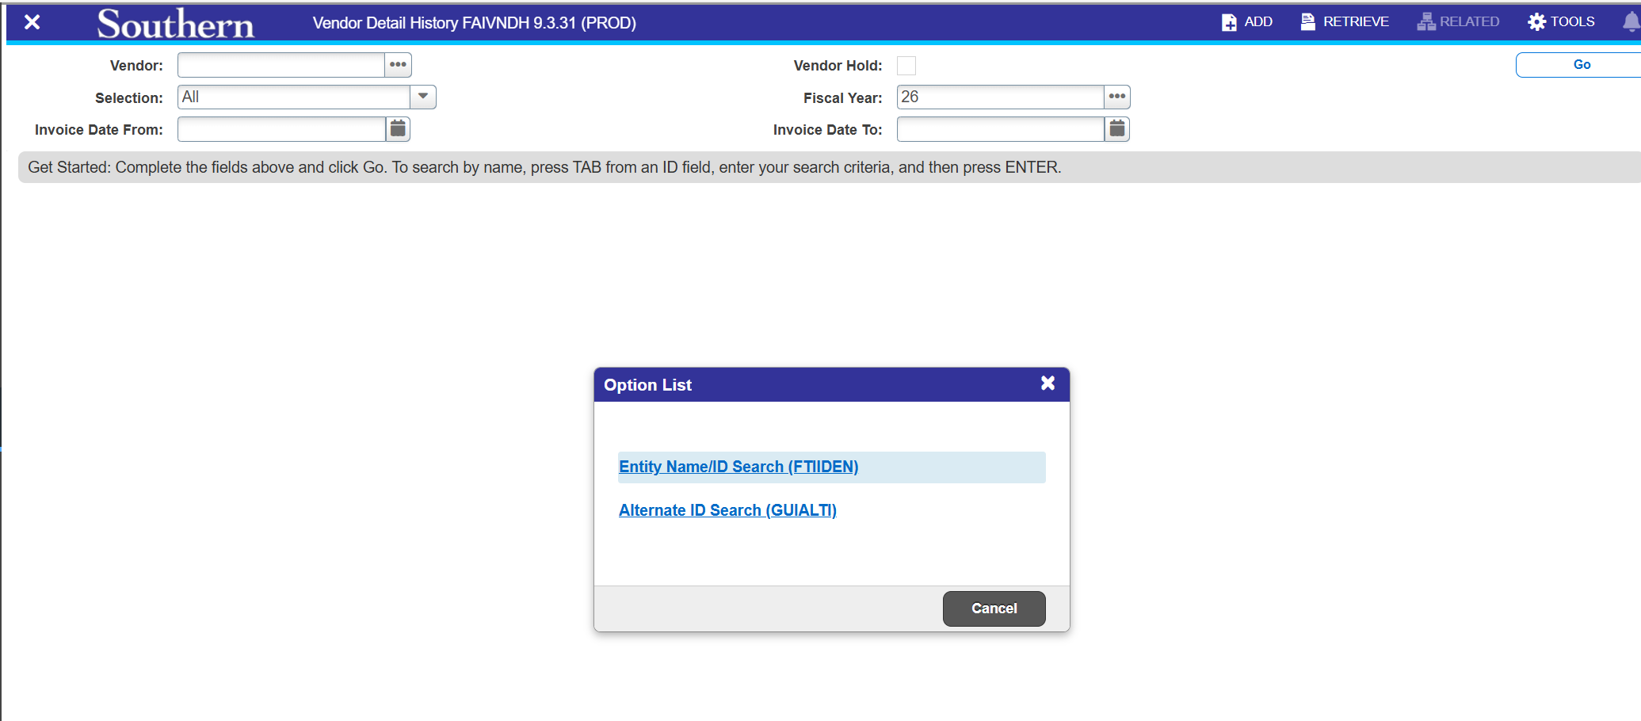

Slide 11
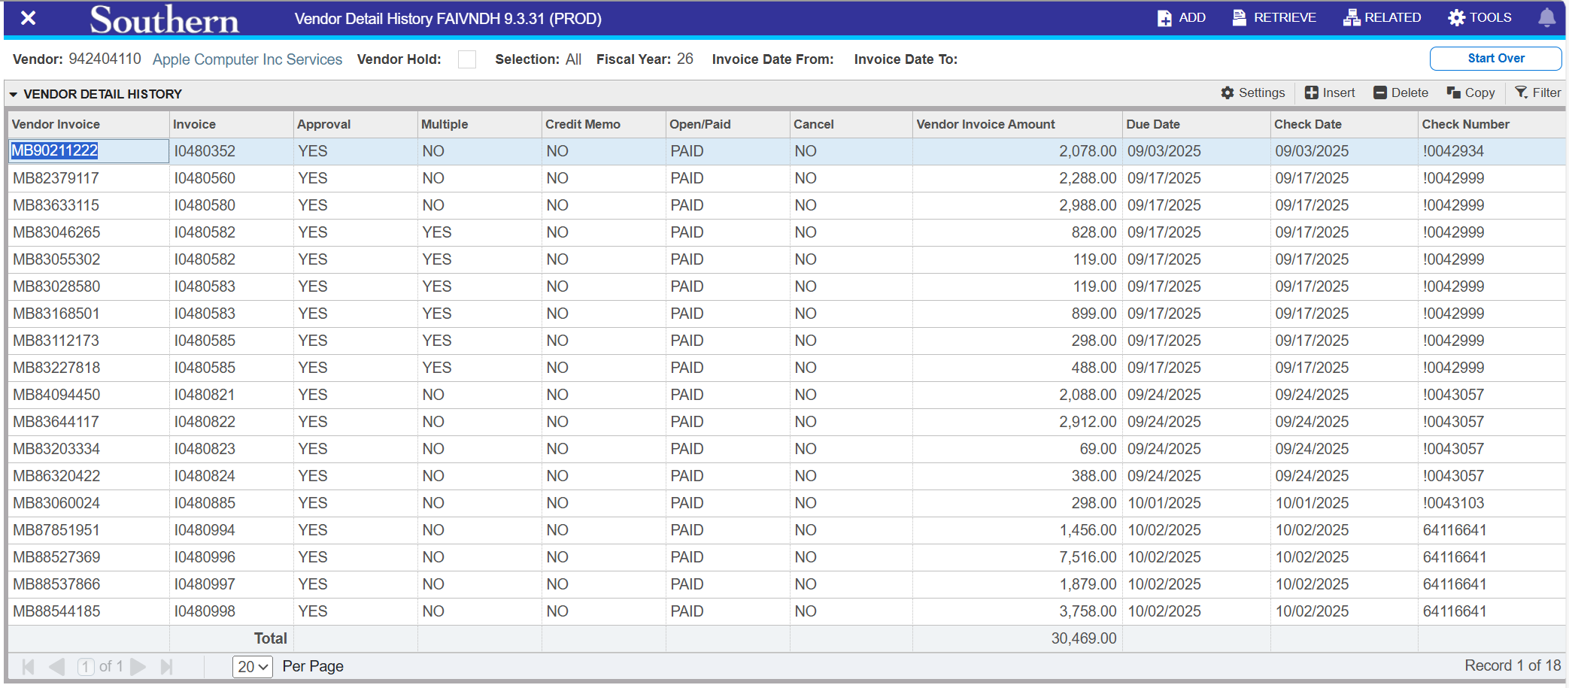

Slide 12
Thank You!

