Slide 1
Southern Connecticut State University Core-CT
Time and Labor Employee Self Service:
Enter Time – Positive Pay Reporters
Notes:
Instructions:
Thank your class for making the time to attend today’s class.
Next Screen:
Welcome

Slide 2
Overview
First, a quick overview of some important things to know before entering time
Notes:
Next Screen:
Overview – Entering Time

Slide 3
Overview - Employee – Entering Time
Time & Labor Self Service allows employees to enter their own time into Core-CT.
Employees access Core-CT via their own login and password
Employees enter their time either on a Positive or Exception basis
The CORE-CT website can be accessed by using the following link:
https://corect.ct.gov:10000/psp/PEPRD/?cmd=login&languageCd=ENG
Notes:
Next Screen:
Overview – SCSU Employee Presentations

Slide 4
Overview - Training Tools
We will use tools created specifically for Self Service Employees.
Presentations
Same presentation will also be available on the Payroll Department website
User Productivity Kit (UPK) Exercises
We use step-by-step instructional exercises to enable you to learn and practice the correct way to use Employee Self Service Time Entry
These exercises are accessed through the “Core-CT Help” tab on the Home Page or through the Core-CT website
Go-Live Labs
As we go-live with Employee Self Service Time Entry, you can come to one of these labs to enter, view and submit your information with a trainer’s assistance. Access lab schedules through the payroll website.
Notes:
Information:
1. Presentations (on SAGE and the Payroll Dept website):
A. Step-by-Step Screenshots with highlights.
B. Navigation Paths, Key Points, Overall Info, etc.
2. UPK exercises (See It!, Try It!, Know It?, Do It!):
A. Entering Time (Positive Time Reporters)
B. Entering Comments - Employee
C. Entering Comments - Supervisor
D. Viewing Payable Time
E. Reviewing and Clearing Exceptions
F. Approving Time (Supervisors)
G. Reports for Approvers (Supervisors)
3. Go-Live Labs:
A. Agency sponsored Go-Live Core-CT entry/view assistance.
Next Screen:
Navigation Path

Slide 5
Overview - Self Service Navigation Path - Employees
Enter Time:
Shortcut -- Time & Labor Pagelet* > Timesheet
*The “pagelet” is a pop-up box menu that appears on the Core-CT Home Page
Notes:
Information:
1. Navigation can be found under Main Menu
Or
Bread Crumbs across the top of the page can be used.
2. The Navigation paths above and the ones used in our presentation examples are from the Main Menu.
Next Screen:
Words to Know

Slide 6
Overview - Time and Labor Basics - Words to Know
Time Reporter
– An employee who reports and submits their time in Core-CT
Exception Time Reporter
– Only reports time that is an exception to their Timesheet’s defaulted schedule, such as updating 8 REG (regular hours) to 8 VAC (vacation hours). These are employees who are members of a bargaining unit.
Positive Time Reporter
– Reports total number of hours worked each day. Does not get paid if hours are not entered on the timesheet (University Assistants and Student Workers).
Notes:
Information:
1. Time Reporter = Employee who enters their time.
2. Exception Time Reporter = Employee who has a defaulted schedule on their
Timesheet and only enters time like Leave Plan usage (VAC), OVT, etc. but
still needs to verify and submit ALL time for every pay period.
3. Positive Time Reporter = Employee who does not have a defaulted schedule on
their Timesheet and must enter all time in order to be paid.
Next Screen:
Words to Know (cont.)

Slide 7
Overview - Time and Labor Basics - Words to Know
TRC – Time Reporting Code that identifies the type of reported time, such as REG is Regular time and OT15 is Overtime
Time Administration
– Core-CT overnight process that validates and converts reported and/or scheduled time into payable time ready for payroll
Payable Time – Validated and Approved time that is ready to be collected by payroll
Exception
– Invalid time that is unable to be collected by payroll until corrected
Notes:
Information:
1. TRC: The type of time.
2. Time Admin: Either validates (accepts) or rejects entries.
3. Payable Time: If a Timesheet entry is NOT on the Payable Time pages,
it has NOT run through the Time Admin process.
4. Exception: A Timesheet entry error that must be deleted or corrected.
Next Screen:
SCSU Training Links

Slide 8
Overview - SCSU Training Links
Payroll Department Website
http://www.southernct.edu/offices/payroll/
PowerPoint Presentations
Employee - Enter Time for Exception Reporters
Employee - Enter Time for Positive Pay Reporters
Employee - View Payable Time Summary
Employee - Manage Exceptions
Employee - Enter Comments
Employee - View Payable Time Detail
Employee - Run Attendance Report
Notes:
Information:
1. TRC: The type of time.
2. Time Admin: Either validates (accepts) or rejects entries.
3. Payable Time: If a Timesheet entry is NOT on the Payable Time pages,
it has NOT run through the Time Admin process.
4. Exception: A Timesheet entry error that must be deleted or corrected.
Next Screen:
Overview – Password Reset

Slide 9
Overview - Password Reset
Time & Labor Security allows employees to have their password automatically reset. For this to work, the “My System Profile” screen must be completed.
The ePay Instruction Presentation contains three ‘must know’ topics for first time Core-CT users:
Logging In For the First Time
Setting A Password Recovery Question and Email
Viewing Your Paycheck Information
Click this link to review this information: http://www.southernct.edu/offices/payroll/SCSU%20ePay%20%20Presentation.pdf
Notes:
Next Screen:
Feature Presentation

Slide 10
Entering Time
Now, the feature presentation!
Notes:
Next Screen:
Process Flow

Slide 11
Process Flow - Employee – Entering Time
Time needs to be revalidated
Errors?
Employee
Enters
Time
Time Admin
Validates
Time
Manage
Exceptions
Yes
No
Entering time is the first step of the self-service process
Approve
Time
Time
Ready for
Payroll
Notes:
Information:
Employee Enters Time is blue again because we are going to look at another Time Reporter: Positive TR, instead of Exception TR.
Next Screen:
Key Points

Slide 12
Key Points - Entering Time – Positive Employee
When entering time, remember the following:
Positive time reporting: No schedules are assigned; Positively must report all time to in order to get paid
Time needs to be reported, validated, cleared from exceptions, and approved before it can be processed by Payroll
All time must be submitted by Friday afternoon in order to allow your supervisor time to review and approve time. Time submitted after Friday may not be processed until the following pay period.
Notes:
Information:
Time entered today won’t be visible on Payable Time pages until the next day (after Time Admin runs).
Exception = Timesheet defaults schedule.
Positive = Timesheet defaults blank.
Next Screen:
Walk Through

Slide 13
Walk-through and Exercise – Positive Employee – Enter Time
Step-by-Step Demonstration.
First, we will walk-through the process together
Scenario: Enter Time as a positive self service employee
Remember the path: Time & Labor Pagelet > Timesheet
Notes:
SCENARIO:
Duncan Donutt is a Positive Time reporter, so he does not have a schedule that defaults.
He needs to enter and submit all of his time for the 2/21/13 pay period:
Next Screen:
Navigation

Slide 14
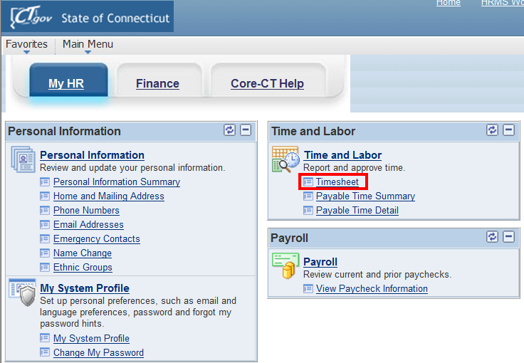
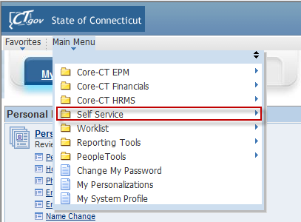
Navigation - Entering Time
Click on Timesheet link on the CORE-CT homepage to access the timesheet
Notes:
Navigation Path:
Main Menu > Self Service > Time and Labor > Timesheet
Next Screen:
Timesheet

Slide 15
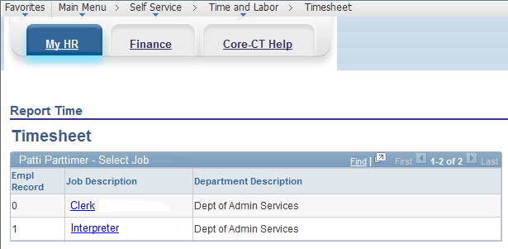
Entering Time (Positive Pay Employee)
If you have multiple jobs you will be able to choose the job you wish to key time for one this screen by clicking the Job Description of appropriate Employment Record

Slide 16
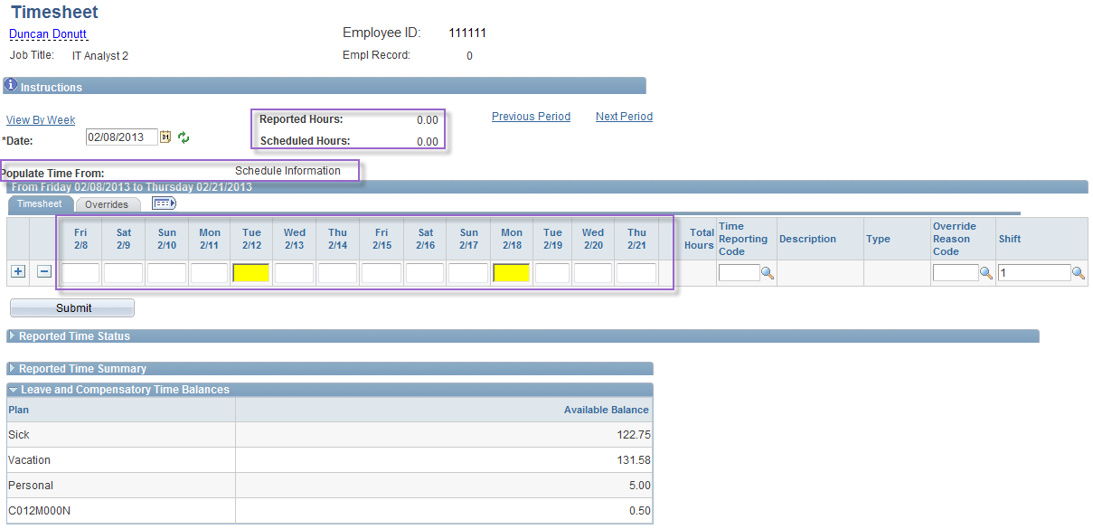
Entering Time (Positive Employee)
Navigate to prior or future pay periods by clicking on “Previous Period” and “Next Period”
Enter TRC code here (REG)
Number of hours worked is keyed in boxes.
Notes:
Information:
Pay period that displays is the one that contains today’s date.
Reported Hours: Entry total populates after the Submit button is clicked.
Scheduled Hours = 0.00, no schedule
Hours and TRC fields: Blank.
***When the Timesheet entries are submitted, watch what happens to the Reported Hours, Scheduled Hours and Total information.
Next Screen:
Timesheet – Enter Hours

Slide 17
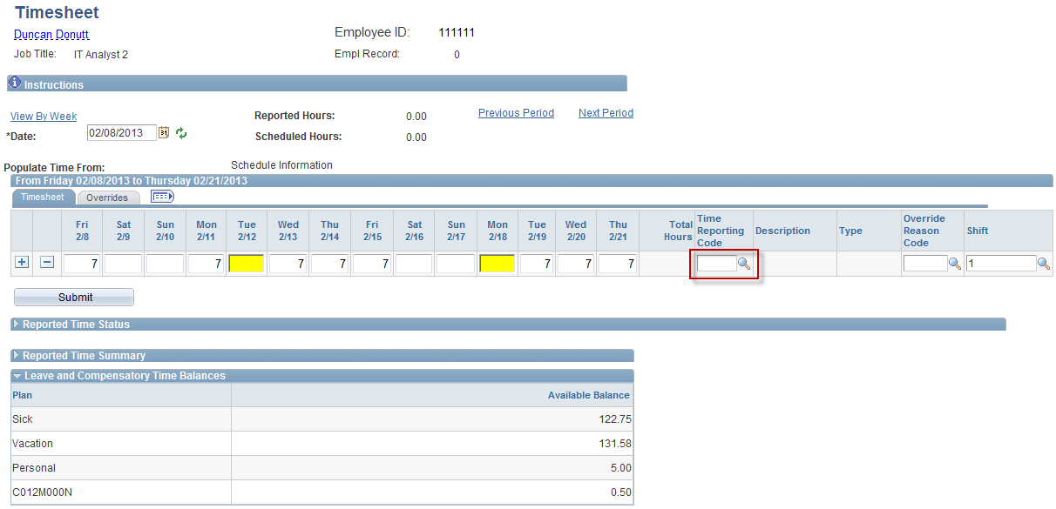
Entering Time (Positive Employee)
Notes:
Information:
None at this time.
Instructions:
TRC: Enter reg.
Next Screen:
Timesheet – Add a Row

Slide 18
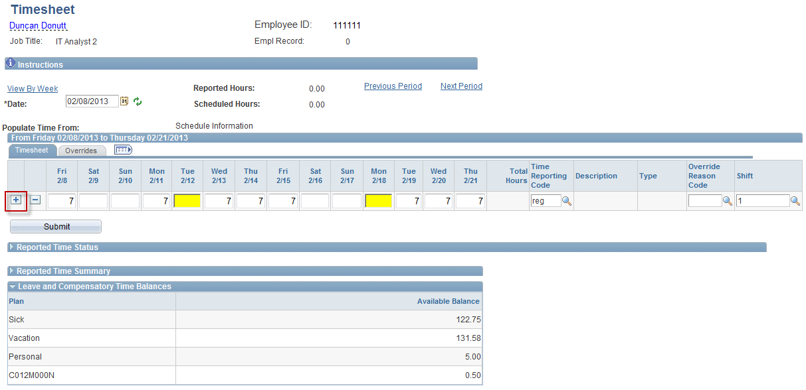
Entering Time (Positive Employee)
Once hours are entered click the “Submit” Button
Notes:
Information:
The Plus button (+) is to Add a Row.
The Minus button (-) is to Delete a Row.
3. Overrides tab: Where you can enter or view Worker’s Comp Claim Number
and/or Combo Code information.
Instructions:
Click Add a Row button (+).
Next Screen:
Timesheet - Enter Hours

Slide 19
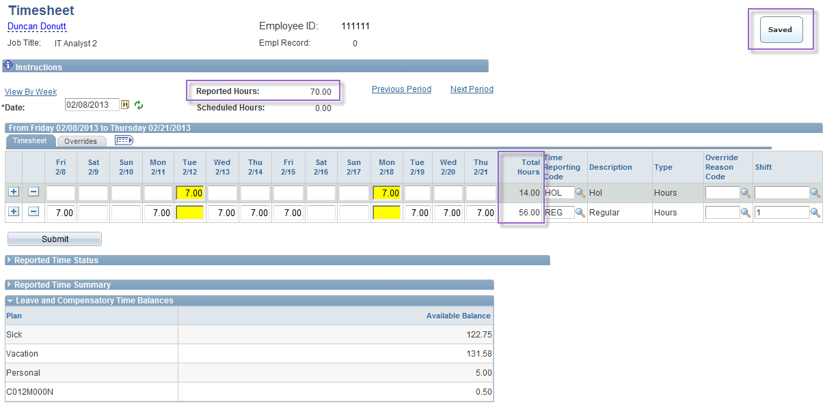
Entering Time (Positive Employee)
Saved box will appear temporarily after the submit box is clicked
56.00
Total hours update once the submit button is clicked. Verify total hours worked.
Notes:
Information:
You’re automatically returned to the Timesheet tab.
Reported Hours: Updated from 0 to 70.
TRC Total: Updated from blank to REG 56 and HOL 14.
Saved message appears.
Next Screen:
Review

Slide 20
Review - Entering Time – Positive Employee
When entering time, remember the following:
Report all time on your Timesheet
Time needs to be reported, validated, cleared from exceptions and approved before it can be processed by Payroll
You can verify there are no exceptions and whether or not time has been approved by querying View Payable Time Summary or Detail on the Monday after the pay period end date
Notes:
Next Screen:
Knowledge Check

Slide 21
Entering Time - Knowledge Check
Answer the following questions:
What four steps are necessary for reported time to become payable time?
Submit Time
Time Administration Process must run overnight
Any exceptions (errors) must be cleared
Approve Time
Notes:
Information:
1. A. Submit Time
B. Time Admin Process
C. Clear Exceptions
D. Approve Time
2. A. Positive TR positively must enter all time.
B. Exception TR only enters updates.
3. Submit Timesheet.
Next Screen:
Practice

Slide 22
Entering Time - Knowledge Check
Answer the following questions:
What is the difference between positive time reporting and exception time reporting?
Positive Time Reporter must enter all hours to be paid (e.g. Students, UA’s)
Exception Time Reporter only makes changes to pre-populated hours (e.g. full-time and permanent part-time employees)
True or False: Both Exception and Positive time reporters must click “submit” on their Timesheet.
TRUE!
Notes:
Information:
1. A. Submit Time
B. Time Admin Process
C. Clear Exceptions
D. Approve Time
2. A. Positive TR positively must enter all time.
B. Exception TR only enters updates.
3. Submit Timesheet.
Next Screen:
Practice

Slide 23
Questions
Questions?
Payroll Department
Beata Winiarski - Payroll Coordinator - (203) 392-5425
Ken Pereira - Payroll Officer - (203) 392-5427
Kommaly Xayasone – Payroll Clerk- (203) 392-5079
Linda D'Addio - Payroll Clerk - (203) 392-5621
Notes:
Information:
Instructions:
Next Screen:
None – End of presentation

