Slide 1
Southern Connecticut State University Core-CT
Time and Labor Employee Self Service:
Manage Exceptions (Errors)
Notes:
Instructions:
Thank your class for making the time to attend today’s class.
Next Screen:
Overview

Slide 2
Overview - Managing Exceptions
Core-CT provides a way for you to manage the exceptions (errors) generated by the Time Administration process.
An Exception or error is an invalid entry on a Timesheet, such as exceeding a SFAM annual limit
One Exception will block out that entire day’s entries, such as 6 REG and 2 SFAM
An Exception that was entered on the Timesheet must be corrected on the Timesheet
All Self Service Employees can locate and correct Exceptions on their Timesheets
Notes:
Next Screen:
Process Flow

Slide 3
Process Flow - Managing Exceptions
Time needs to be revalidated
Errors?
Employee
Enters
Time
Time Admin
Validates
Time
Manage
Exceptions
Yes
No
Approve
Time
Time
Ready for
Payroll
Notes:
Next Screen:
Key Points

Slide 4
Key Points - Managing Exceptions
When managing exceptions, remember the following:
Exceptions should be resolved between employee and supervisor, if questions arise contact Payroll
Exceptions corrected through the Timesheet page do not clear until they are processed through the Time Administration process/overnight process
Most exceptions can be located and corrected directly on the Timesheet
If one portion of time generates an error, all time reported for that day is not processed.
Notes:
Next Screen:
Walk Through

Slide 5
Walk-through and Exercise - Managing Exceptions
Step-by-Step Demonstration.
First, we will walk-through the process together
Scenario: Locate and Correct Exceptions on the Timesheet
Notes:
SCENARIO:
Maria Peeps entered her time for the 2/21/13 pay period yesterday.
She viewed the Payable Time pages and discovered 8 hours of SFAM were
missing.
She is going to the Timesheet to view and correct the exceptions, if possible.
Next Screen:
Navigation

Slide 6
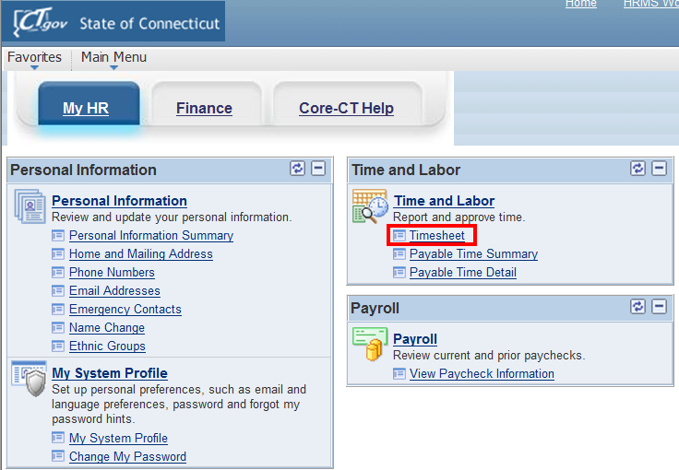
Managing Exceptions
Click on the Timesheet link on the CORE-CT homepage
Notes:
Next Screen:
Timesheet

Slide 7
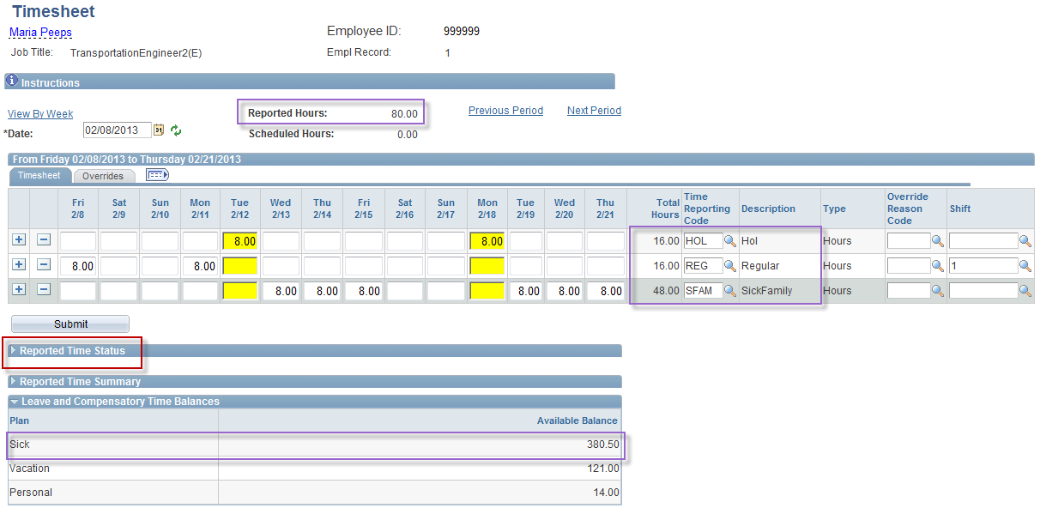
Managing Exceptions
Click on “Reported Time Status in order to review time for Exceptions.
Remember this must be done the day after entering time.
Notes:
Information:
Reported Hours: 80.00: A. HOL: 16.00 B. REG: 16.00
C. SFAM: 48.00
2. Sick balance: 380.50
3. Reported Time Status: View Exceptions and Comments, when applicable.
Instructions:
Click Reported Time Status link.
Next Screen:
Reported Time Status – Alarm clock icon

Slide 8
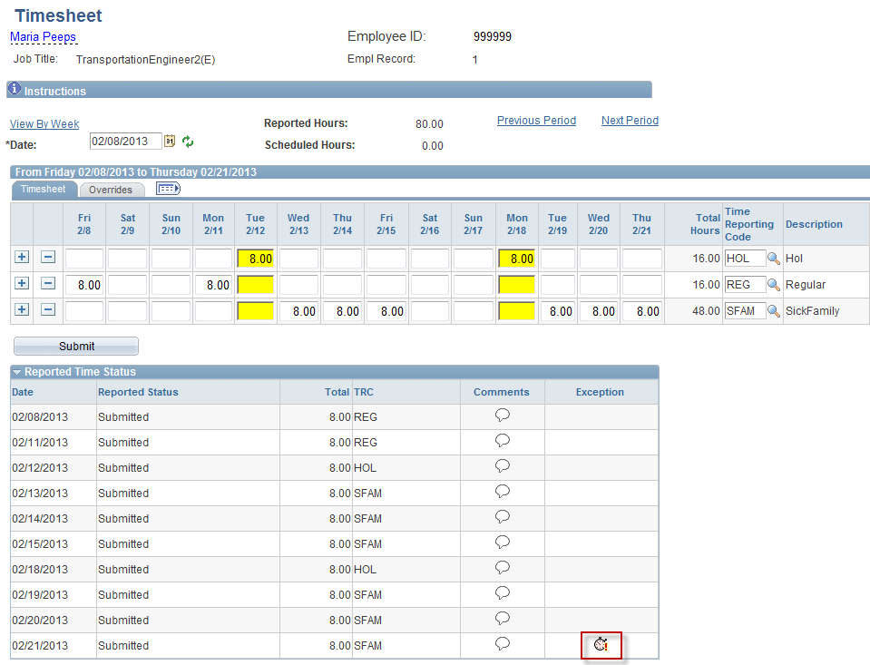
Managing Exceptions
Alarm clock icons in the Exception column indicate and exception is caused by that time entry
Click on alarm clock icon to view exception
Notes:
Information:
For more information about the exception click the alarm clock icon.
Instructions:
Click the alarm clock icon.
Next Screen:
Exceptions

Slide 9
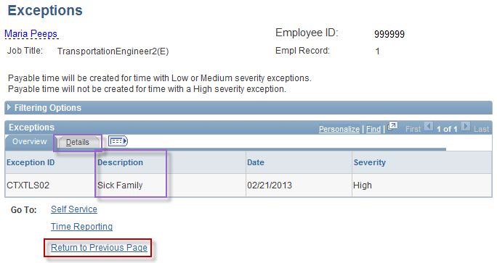
Managing Exceptions
The Exceptions page will indicate description type and severity of exception.
TRC needs to be changed to correct exceptions
If needed, contact Payroll for further explaination
Click on “Return to Previous Page” to return to the timesheet.
Notes:
Information:
The Exceptions page provides more information about what caused the exception (i.e., in this example Sick Family).
Click on the Details tab for information about clearing the exception
SCENARIO:
Maria Peeps contacted her supervisor.
Her supervisor advised her that the annual sick family limit for her bargaining unit is 40 hours.
Maria decided to use VAC in place of the SFAM entry.
Instructions:
Click the Return to Previous Page link.
Next Screen:
Timesheet – Delete Exception entries

Slide 10
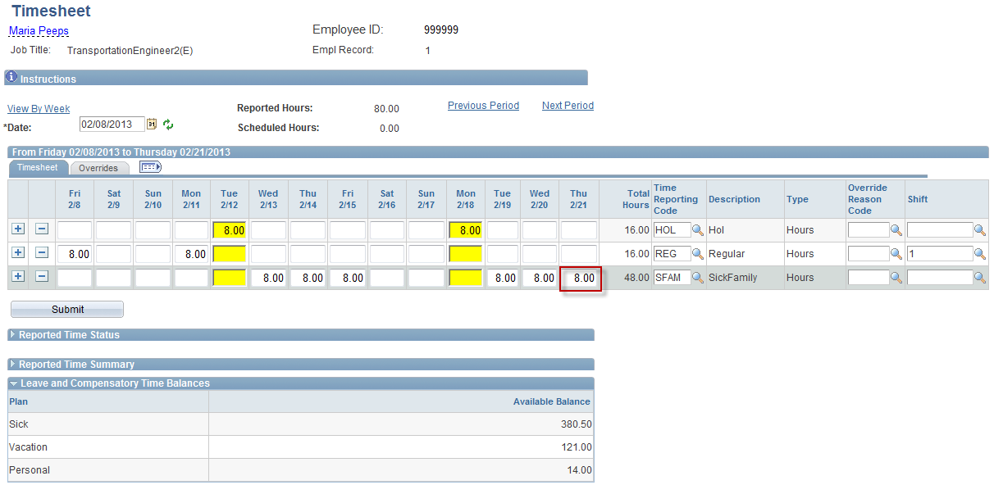
Managing Exceptions
Begin by removing the hours that caused the exception.
Click in the appropriate box and delete.
Notes:
Information:
Always delete the exception entry before you enter its replacement to prevent double entry.
Instructions:
Delete the 2/21 entry.
Next Screen:
Timesheet – Add a new row

Slide 11
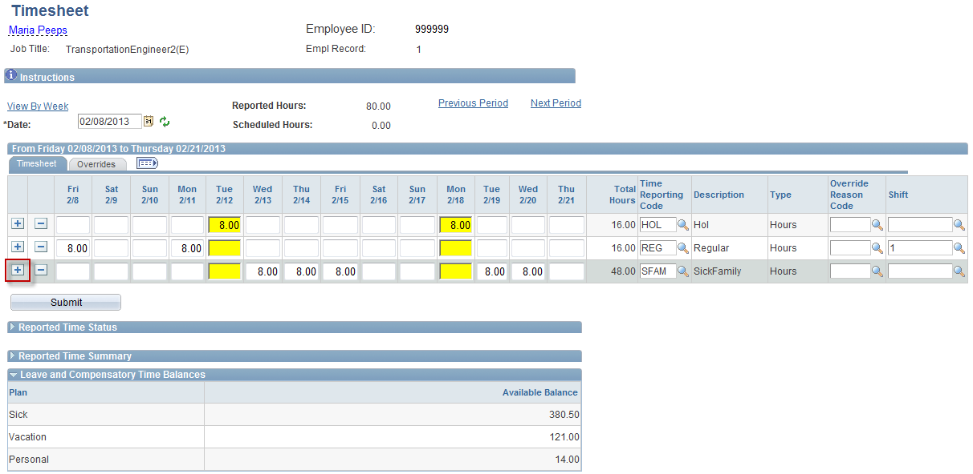
Managing Exceptions
Click on the “+” button to add a row to the timesheet.
Notes:
Information:
None
Instructions:
Click Add a Row button (+).
Next Screen:
Timesheet – Enter new hours

Slide 12
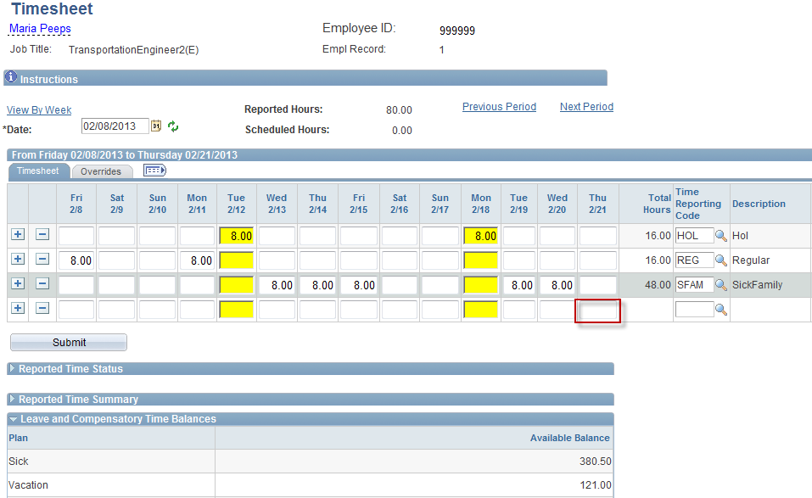
Managing Exceptions
Enter hours that caused the exception.
Notes:
Information:
None
Instructions:
4th Row: 2/21 column: Enter 8.
Next Screen:
Timesheet – Enter TRC

Slide 13
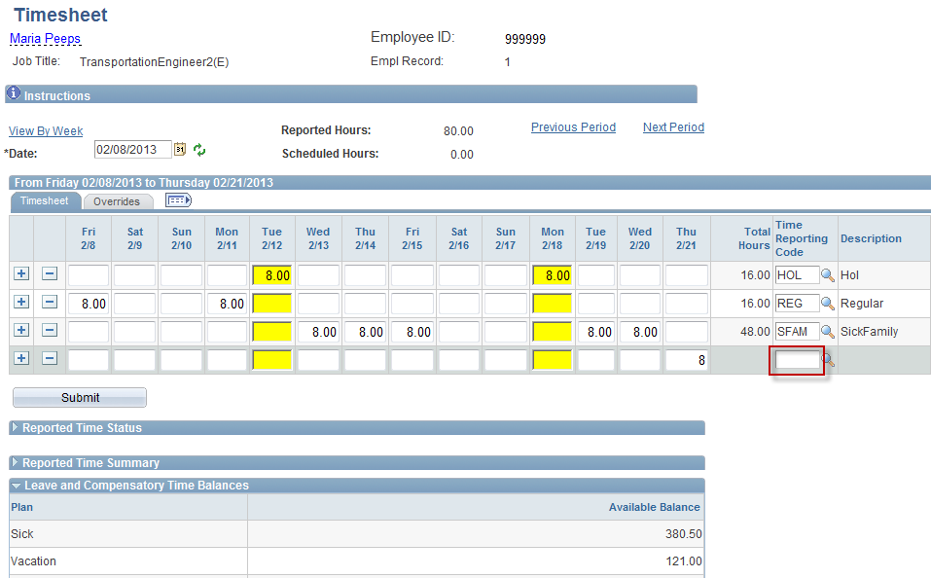
Managing Exceptions
Assign new TRC code to time.
Notes:
Information:
You can replace an exception entry with any other options that are within your Agency and Bargaining Unit rules.
Instructions:
4th Row TRC: Enter vac.
Next Screen:
Timesheet – Submit button

Slide 14
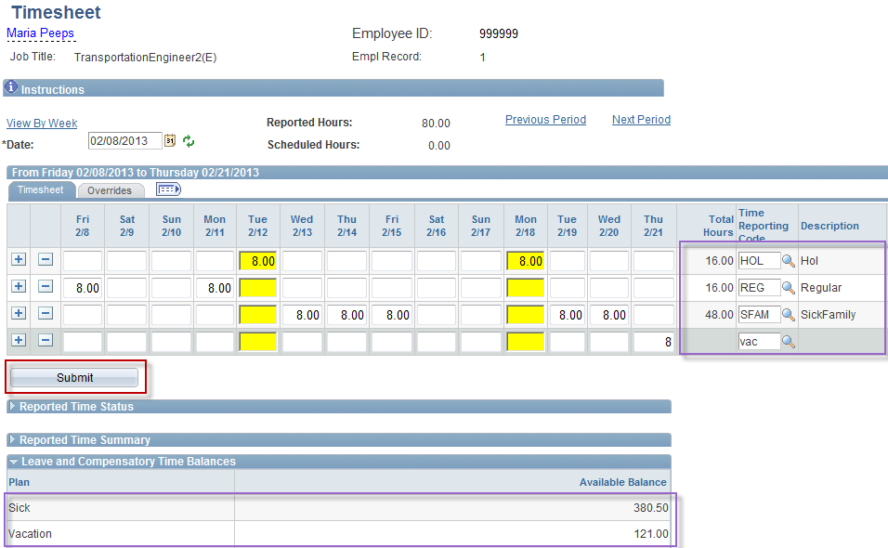
Managing Exceptions
Click the “Submit” button to save changes.
Notes:
Information:
Note the TRC Total and Sick and Vacation Balances change when the Timesheet is submitted (Sick 380.50, Vacation 121.00)
Instructions:
Click the Submit button.
Next Screen:
Timesheet – Saved

Slide 15
Review - Managing Exceptions
When managing Exceptions, remember the following:
Exceptions are entered on the Timesheet and must be corrected or deleted from the Timesheet to clear the Exception
Exceptions can be viewed on the Timesheet’s Reported Time Status link
One Exception will block that entire day from processing
Corrected Exceptions must process through Time Admin in order to clear
Notes:
Next Screen:
Knowledge Check

Slide 16
Knowledge Check - Managing Exceptions
Answer the following questions:
When are Exceptions displayed on the Timesheet?
After the Time Admin process runs to validate or reject Timesheet entries.
What two things need to occur in order for Exceptions to clear?
Delete or Replace the Exception time
Time Admin process
What Timesheet link do you click to view Exceptions?
Reported Time Status
Notes:
Information:
After the Time Admin process runs to validate or reject Timesheet entries.
A. Delete or Replace the Exception time B. Time Admin process
Reported Time Status
Next Screen:
Questions?

Slide 17
Questions
Questions?
Payroll Department
Beata Winiarski - Payroll Coordinator - (203) 392-5425
Ken Pereira - Payroll Officer - (203) 392-5427
Kommaly Xayasone – Payroll Clerk- (203) 392-5079
Linda D'Addio - Payroll Clerk - (203) 392-5621
Notes:
Information:
Instructions:
Next Screen:
None – End of presentation

