Slide 1
Searching for Jobs

Slide 2
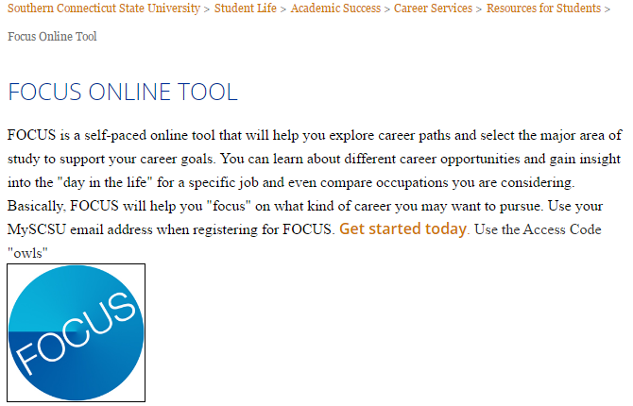
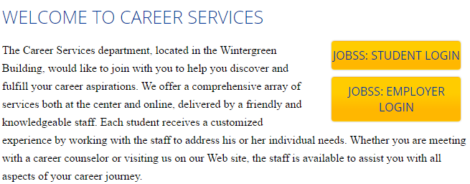
Identifying Job Choices
Assess yourself and narrow down your career options by using FOCUS: http://www.southernct.edu/student-life/academic-success/career-services/students-resources/focus.html
Research employers and jobs that might interest you through JOBSs: https://www.southernct.edu/student-life/academic-success/career-services/

Slide 3
What Can You Do?
Visit the Center for Career Advising so you can meet one-on-one with a career advisor
Become familiar with FOCUS, a web based assessment tool that can help you find out more about careers that suit your interests and skills
Schedule an informational interview with an employer of interest
Create a JOBSs account; on JOBSs you can find thousands of part-time and full-time opportunities, as well as, internship and co-op openings
Define your goals; keep a job search journal

Slide 4
Create a Resume and Cover Letter
Review the Career Advising Handbook to find samples of resumes and cover letters to guide you in making your own: https://www.southernct.edu/student-life/academic-success/career-services/students-resources/UPDATED%20HANDBOOK%202017.pdf
Meet with a Career Counselor or a Career Peer to refine your resume and cover letter
Post your resume and cover letter on JOBSs (under the documents tab) once you refine your resume
Remember to tailor your resume/cover letter for each position you apply for

Slide 5
Developing Interviewing Skills
Research the company before attending an interview
Dress professionally and clean
Be friendly, but professional
Prepare and practice standard questions
Arrive 10 minutes early for your interview
Bring copies of your resume
Turn your phone OFF
Maintain eye contact
Prepare questions for the employer
Be able to explain why you want the job
Be yourself!

Slide 6
Where to Find Jobs
Connect with the Career Advising Department
Attend Career Fairs
Register in JOBSs
Search on the internet to find companies you might be interested in working for
Professional organizations, publications, and websites
Staffing agencies like Indeed
Networking! (social and professional sites, events, informational interviews, business cards, etc.)

Slide 7
Questions?? Contact us!
Aimee Piccin
Associate Director of Academic and Career Advising
piccina1@southernct.edu
203-392-6517
Kelianna Bonn
Graduate Assistant
bonnk2@southernct.edu
203-392-6539
Search: Career Services

