Slide 1
$mart Money Management
Financial Literacy & Advising
www.southernct.edu/financial-advising
DeLucaL2@southernct.edu, 203-392-8862
Lew DeLuca, Wintergreen Building, 108E

Slide 2
Financial Literacy Quiz
True or False: Housing prices in the United States can never go down?
True or False: Buying a single company’s stock usually provides a safer return than a stock mutual fund?
Considering a long time period (for example, 10 or 20 years), which asset described below normally gives the highest returns?
Stocks
Bonds
Savings Accounts
Precious Metals
Imagine the interest rate on your savings account was 1% per year and the inflation rate was 2%. After 1 year, how much would you be able to buy with the money in this account?
More than today
Exactly the same
Less than today
Suppose you had $100 in a savings account and the interest was 2% per year. After 5 years, how much do you think you would have in the account if you left the money to grow?
More than $102
Exactly $102
Less than $102
https://www.federalreserve.gov/publications/files/2017-report-economic-well-being-us-households-201805.pdf

Slide 3
Life = Making Decisions
6-10 Money Decisions Everyday
$4.00 coffee/day = $1,460/year
https://www.ted.com/talks/joachim_de_posada_says_don_t_eat_the_marshmallow_yet Marshmallow Test
https://www.youtube.com/watch?v=Y0PjzgRY_fA Sunnier Financial Days
http://www.southernct.edu/financialaid/scholarships.html Scholarships
GO TO CLASS! $59

Slide 4
$ Saving Tips
Track Expenses (LearnVest, Mint, YNAB)
Rent textbooks or buy used (Loan from Multicultural Center in ASC 234)
Use student discounts (UNiDAYS, U-Pass)
Pay Unsub. loan interest now
Limit financial aid refunds

Slide 5
Monthly
50% Essentials/Needs
30% Housing, 10% Groceries, 5% Utilities, 5% Transportation to & from work
20% Future
Emergency Fund (6 mons.), Debt, Retirement, 529 College Savings Fund
30% Lifestyle/Wants
Play, Vacation, Charity
https://www.youtube.com/watch?v=6Ib-bdko5cE Budgeting

Slide 6
Time is money

Slide 7
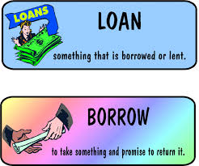
Loans
Borrow money now, repay with interest later
https://www.igrad.com/videos/how-to-nslds-video NSLDS
$39,400 national student debt vs. $26,946 Southern (~$300/month for 10 years)
Student Loan Rule of Thumb
https://www.youtube.com/watch?v=tu1bGgOuyww&feature=youtu.be
Student loans = Investment in Yourself
College graduates earn $1 million more in lifetime earnings than high school graduates

Slide 8
Credit Cards
Use 1 card sparingly: no annual fee, a rewards program (Bankrate.com & nerdwallet.com)
Pay bill in-full and on-time (46% do not)
---OR---
$1,000 bill @ 25% interest rate and pay $40 minimum for 7 yrs. & 2 mo. = $1,840
https://www.youtube.com/watch?v=qKHCOdH64Vo How to use
https://www.youtube.com/watch?v=dslSyGRM6s4 How to Improve

Slide 10
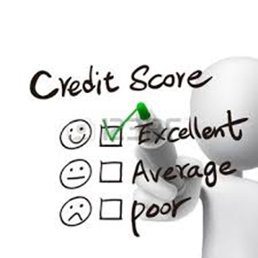
Credit Report/Scores
Use CREDIT to buy: a car, a home, insurance and when applying for a job or credit card
FREE @ www.annualcreditreport.com
Negative information remains for 7-10 years
Credit score > GPA

Slide 11
FICO Credit Score

Slide 12
Life After College
$42,000 Gross pay = $3,500/month
$34,227 Net pay = $2,852/month
Pay yourself first - save 20% earnings ($570/month)
Investing: IRA, 401k/403b (co. match), pension
120 - Age = stocks/equities
https://www.bing.com/videos/search?q=ted+talk+the+best+class+you+never+took&FORM=VIRE2#view=detail&mid=D9B2B596BF2BD6E4BD31D9B2B596BF2BD6E4BD31 One Life-Changing Class
https://www.reisupllc.com/your401k/compound-interest Reis Up

Slide 14
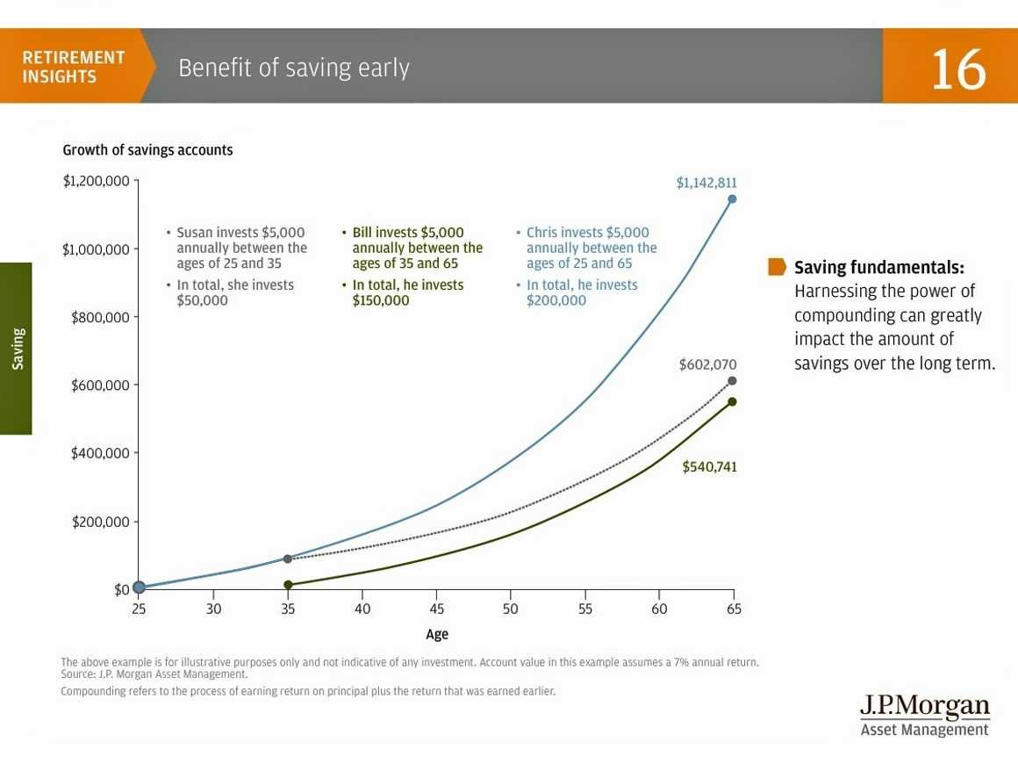
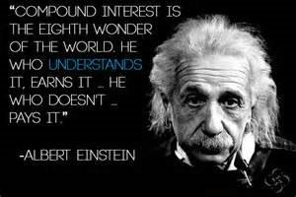

Slide 15
The Index Card, by Helaine Olen and Harold Pollack

