Slide 1
Recognize, Respond & Refer: Supporting Students in Distress
Counseling Services
Nick Pinkerton
Chrissy Fuchs
Notes:
Introductions

Slide 2
What's ahead?
Current Trends in Student Distress
Recognize, Respond, and Refer
Additional Professional Development Opportunities
Questions and Discussion

Slide 3
Current Trends

Slide 4
The Student Mental Health Crisis
More than 1/3 of college students report symptoms of a mental health disorder (WHO, 2018)
Suicide is the 2nd leading cause of death among college students.
Mental health concerns are the 2nd leading cause of students dropping out of school.

Slide 5
The Student Mental Health Crisis
Demand for counseling has grown substantially (7x rate of enrollment) and will likely continue.
Counseling Services has no waitlist, and emergency appointments are available daily.
We all have an important role to play to promote positive mental health and well-being.

Slide 6
Student Mental Health Drivers
Food, Housing, and Financial Insecurity
Increased Awareness and Decreased Stigma
Improved Support Systems and Referral Processes
Source: EAB, Meeting the Escalating Demand for Mental Health Services, 2018

Slide 7
Decreasing Social Interaction
Time Spent Socializing with Friends (hours per week)
1987–2016
Eagan, M. K., Stolzenberg, E. B., Zimmerman, H. B., Aragon, M. C., Whang Sayson, H., & Rios-Aguilar, C. (2017). The American freshman: National norms fall 2016. Los Angeles: Higher Education Research Institute, UCLA.

Slide 8
Increasing Social Anxiety
“I use my phone to avoid interacting”
“I don’t like talking in person or on the phone”
“I get really nervous to raise my hand in class”
“I don’t use my professor’s office hours”
“I don’t use public bathrooms”
“I hate walking into a room when people are already seated”
“I don’t talk to people I don’t know very well”
“I can’t initiate conversations”
“I get really nervous in large groups of people”
“I am always afraid I will embarrass myself”
“I worry that I will offend or burden others”
Some types only related to public speaking or performance

Slide 9
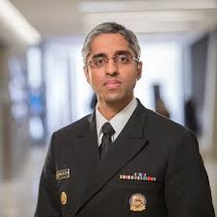
Increasing Loneliness
Loneliness is associated with a reduction in your lifespan that is as severe as smoking 15 cigarettes a day.
Former Surgeon General
Dr. Vivek Murthy
Source: Cigna Study of 20,000 Americans, May 2018

Slide 10
Impact of COVID-19 on College Students-Nationally
80% of college students have experienced a negative impact on their mental health during COVID-19, with 20% reporting that their mental health has significantly worsened
3/4 of students are open to using telehealth
Only 35% of students have ever used telehealth, and most who did were satisfied
66% of students reported greater financial stress
60% of students reported more difficulty accessing mental health care
Activeminds & Healthy Minds Network

Slide 11
Impact of COVID-19 on Students at SCSU

Slide 12
Recognize Respond Refer

Slide 13
Recognize
Look for groupings, frequency, and severity.
Safety Risk Indicators
Academic Indicators
Physical Indicators
Psychological Indicators

Slide 14
Recognize
Safety Risk Indicators
Inappropriate anger, hostility, or aggression
Verbal, written, or implied references to suicide, violence, or self-injurious behavior
Observable hopelessness, rage, worthlessness, isolation, despair, acting out, suicidal ideation, or violent behavior
Stalking, harassing, or threatening

Slide 15
Recognize
Academic Indicators
Sudden reduction in quality of work and grades
Repeated absences
Concerning content in writing or presentations (e.g., violence, death)
Seeks more personal support than academic support
Continuous disruptions in the classroom

Slide 16
Recognize
Physical Indicators
Notable deteriorations in physical appearance, grooming, hygiene, or weight
Excessive fatigue or sleep problems
Intoxication, hangover, or smells of alcohol or marijuana
Observable signs of injury (i.e., facial bruising or cuts)

Slide 17
Recognize
Psychological Indicators
Discloses significant personal stress with family, finances, depression, grief, or thoughts of harming self or others
Disoriented, bizarre thinking, or loss of contact with reality
Inappropriate tearfulness, panic, irritability, or apathy
Verbally abusive behaviors including taunting, badgering, and intimidation
Expressions of concern about the student by peers

Slide 18
Respond
Think about a time that you were in crisis or distressed.
Without sharing the details...
​
What were you thinking?​
How did you behave?​
How did you feel?​
What was helpful and not helpful?
Notes:
Helpful: Listening, someone just sitting with us, someone conveying an understanding of what we experiencing, someone expressing that they care about us and our well-being
Not Helpful: Judging, minimizing, implying that the crisis is the individual’s fault
Responses that are minimizing or judgements;
“When that happened to me…”
“I know what this is like”
“I understand exactly what you are going through”
“Everything will be okay”

Slide 19
Respond
Safety First
Be Proactive
Be Direct
Active Listening
Concrete Help
Consultation & Documentation
Share What You Know
Notes:
Safety First
Staying safe is the top priority, so don’t hesitate to call for help if the student displays threatening or potentially violent behavior.
Be Proactive
Engage students early, pay attention to warning signs, and set limits on disruptive behavior.
Be Direct
Don’t hesitate to ask direct questions about whether a student is under the influence of drugs and alcohol, feeling confused, or having thoughts of harming themselves or others. Asking about risk will not instill or increase the risk.
Active Listening
Make eye contact and give your full attention. Take a few breaths and use a calm voice. Restate what the student has said to make sure you understand what is causing the distress and/or what they are asking for help with.
Concrete Help
Provide clear and concise recommendations and support. Help them get to the next step (i.e., contact the academic advisor with the student to setup an appointment; help them schedule an appointment at the counseling center).
Consultation and Documentation
Document your interaction and reach out to your appropriate department chair/supervisor after the incident.
Share What You Know
The Family Education Rights and Privacy Act (FERPA) permits communication regarding a student of concern when there is a legitimate need to know.

Slide 20
Respond: Modes of Communication
Paraphrase
Restating what you heard
Probing
Seek information
Open ended questions
Assurance
Support and caring
Validation
Interpretation
Advice
Explain what problem means
Suggest resource/referrals
Early in Conversation
Notes:
Remember:You are not taking on the role of counselor. You need only listen, care and offer resource and/or referral information.

Slide 21
Respond
Direct
direct intervention
Distract
creating a distraction to diffuse situation
Delegate
inviting help from others

Slide 22
Respond
Let's give it a try!
Facilitators model
What did you notice?
What was helpful?
Notes:
Senario:

Slide 23
Refer
Important on and off-campus resources. (*Confidential resources)
Emergency
University Police, 203-392-5375
Emergency Services, 911
*CT Crisis Response, 211
*National Suicide Hotline, 800-273-8255 / Text CONNECT to 741741
Off Campus
*Yale New Haven Hospital, 203-688-4242
*Women and Families Center, 203-389-5010
*Umbrella Center for Domestic Violence, 203-736-9944
Mandatory Reporting
In addition to referring a student to resources, any sexual or gender-based harassment or assault requires mandated reporting. For questions, call the Violence Prevention and Victim Advocacy and Support (VPAS) Office, 203-392-6946
On Campus
Student Support Team, 203-392-5556
Student Conduct, 203-392-7126
Title IX Office, 203-392-5568
VPAS, 203-392-5568
*Health Services, 203-392-6300
*Counseling Services, 203-392-5475
*Marriage and Family Clinic, 203-392-5475
Wellness Center, 203-392-6526
Sexuality and Gender Equality, 203-392-8989
Multicultural Center, 203-392-5888
Disability Resource Center, 203-392-6828
Academic Success Center, 203-392-5367
Student Support Team Referral
Student of Concern
Sexual Misconduct
Basic Needs

Slide 24
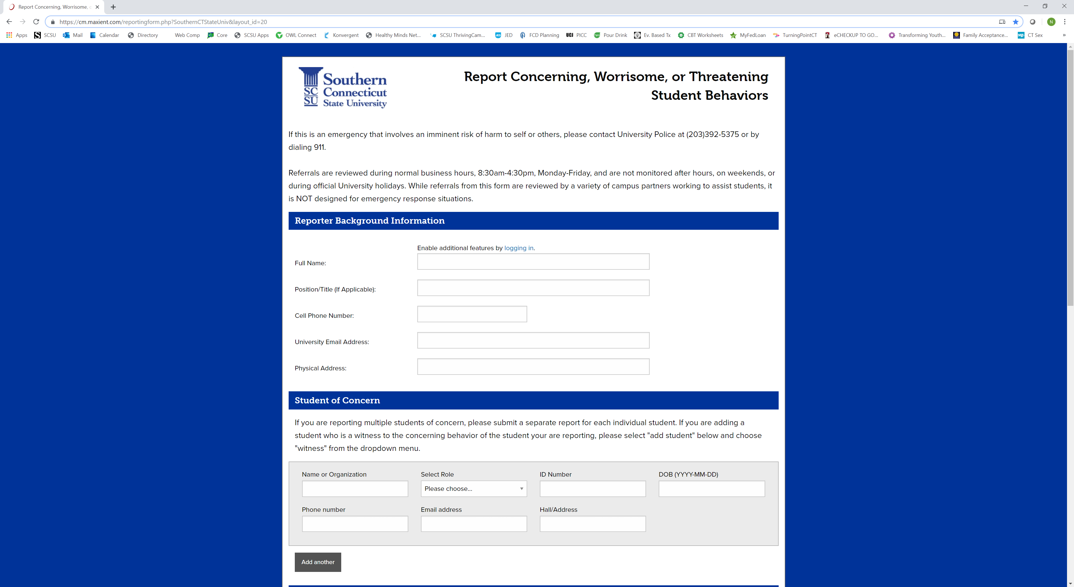
Student Support Team Referral

Slide 25
LiveSafe

Slide 26
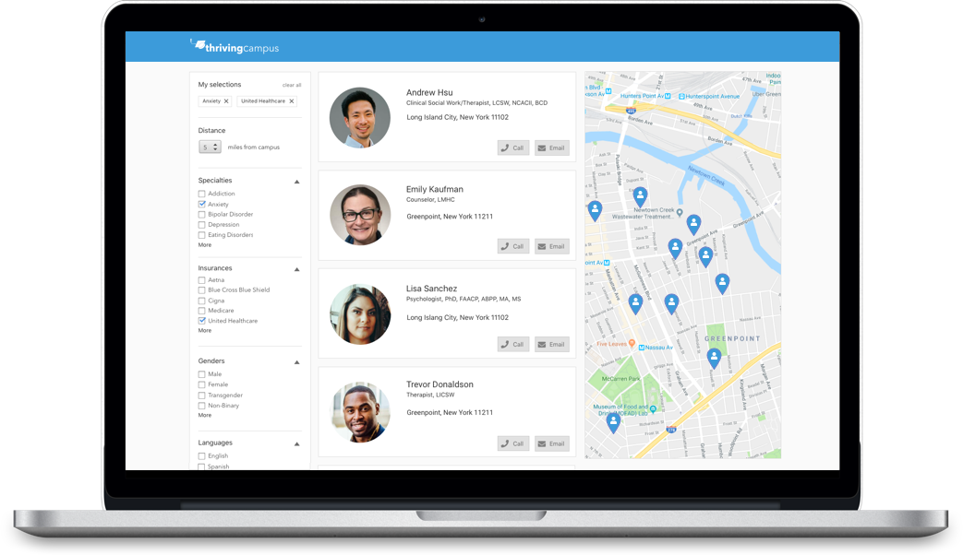
ThrivingCampus

Slide 27
Professional Development Opportunities
Campus Connect Suicide Prevention Training
In-depth training on suicide with actual practice in responding effectively.
Contact Counseling Services at 203-392-5475
Student Well-Being and Resiliency Training
Practical strategies to help your students improve their mindset and prevent crises.
Contact Counseling Services at 203-392-5475
Bystander Intervention Training
Strategies for effectively responding to issues of concern in our community.
Contact Violence Prevention, Victim Advocacy and Support Center at 203-392-6946

Slide 28
Questions and Discussions
What and when are the more predictable challenges you observe in students?
What steps can be taken to mitigate these challenges?
What steps can be taken if further support and intervention is warranted?

