Slide 1
Healthy Communication
Counseling Services
Southern Connecticut State University

Slide 2
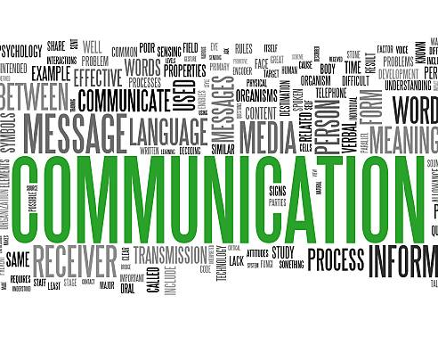
What’s ahead?
Why Is This Important?
What Does Conflict Look Like?
How to Have GREAT Conversations
Notes:
Communication and relationships are everywhere!

Slide 3
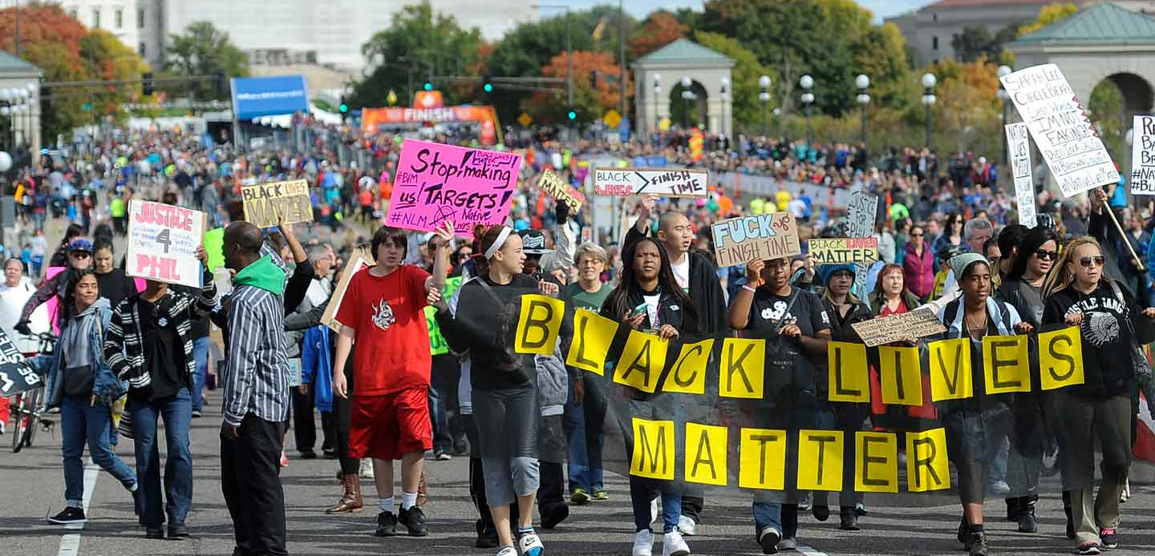
Why is this important?
Current challenges with civility, respect, and communication
2020 - a global pandemic, heated election, racial injustice
"Being able to discuss our genuine disagreements remains important. At the root of those disagreements are differences in core beliefs...While our differences are often rooted in divergent views, that does not mean we cannot find common ground"
(Hawkins, Yudkin, Juan-Torres, & Dixon, 2018)

Slide 4
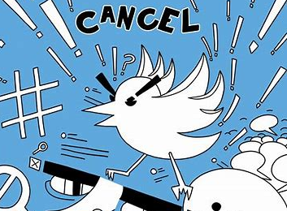
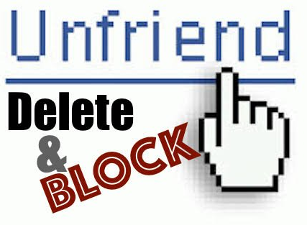
Why is this important?
How many of you avoid conflict?
How many of you have unfriended/blocked someone on social media? Why?
Has anyone been ghosted/canceled?
Are you reluctant to bring up certain topics in class?
Notes:
Some people feel that there are not many "safe subjects" and that every conversation has the potential to end in an argument,
We’re less likely to compromise and we’re not really listening to each other.

Slide 5
Why is this important?
"I'd rather text than talk."
When I ask people “What’s wrong with having a conversation?” People say, “I’ll tell you what’s wrong with having a conversation. It takes place in real time and you can’t control what you’re going to say.”
(Turkle, 2012)
Notes:
Ever find yourself feeling that you'd rather text than talk?
Thoughts on Sherry Turkles statement?
“Human relationships are rich and they're messy and they're demanding. And we clean them up with technology. Texting, email, posting, all of these things let us present the self as we want to be. We get to edit, and that means we get to delete, and that means we get to retouch, the face, the voice, the flesh, the body -- not too little, not too much, just right.”
Data about text preference

Slide 6
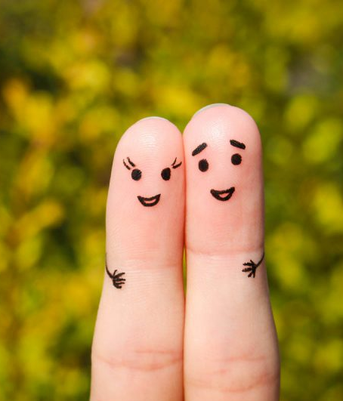
Why is this important?
Close relationships involve discomfort.
Setting boundaries involves discomfort.
Disagreeing involves discomfort.
Asserting your needs involves discomfort.

Slide 7
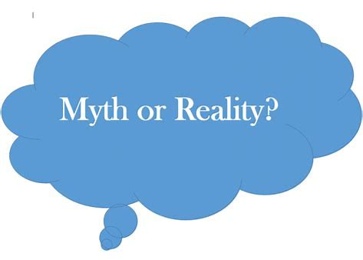
What does conflict look like?
When you think of conflict, what comes to mind?
Conflict is avoidable.
Conflict is inevitable and a normal part of enduring relationships
Conflict destroys relationships
Lack of productive communication leading to resentment and contempt destroys relationships
Conflict is "bad"
Can bring about new ways of thinking, solutions and ideas
(University of Pittsburgh, 2015-2020)
Notes:
Discussion:

Slide 8
What does conflict look like?
What are your observations about this conflict? ​
How was it productive or not productive?
(Wilde, 2019)
Booksmart – Molly and Amy
(Wilde, 2019)

Slide 9
How to have GREAT conversations
Goals
Rapport
Empathic Listening
Assertiveness
Technique

Slide 10
Great COnversations
Hopes - Objective is not to get the other side to do what we want them to do, but how to meet needs of each other
Movie clip: How did they do with this?
Fears – What are your fears about the conflict/conversation? Fear may lead to avoidance
What were Amy's fears?
Choices – Make thoughtful, deliberate decisions about which conversations to have; pick your battles well
Goals
Rapport
Empathic Listening
Assertiveness
Technique

Slide 11
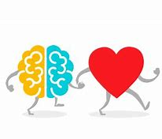
Great COnversations
Discussion: How do we enter a conversation?
Soft start up-make observations without evaluation, "I" not "You"
Partnership – Work to create a caring, respectful connection. Respect the reality of the other's experience. Reflect back what the other has said. Use open ended questions.
Charity – Assume positive intent
Forgiveness –cost of making a misstep; faux pas are inevitable
Goals
Rapport
Empathic Listening
Assertiveness
Technique
Notes:
Movie clip: examples?

Slide 12
Great COnversations
Discussion: What is the difference between empathy and sympathy?
Curiosity - What is the other person really saying? Listen for feelings, needs, requests
Movie clip example
Understanding – Listen for understanding, not agreement
empathy is understanding what others are experiencing
empathy fuels connection.
Learning- "If your mouth is open you're not learning"-Budda . WAIT (Why Am I Talking?)
Goals
Rapport
Empathic Listening
Assertiveness
Technique

Slide 13
Great COnversations
Clear - The clearer we are, the more likely we are to get what we are requesting. "I" statements
Concise – Be direct and specific positive concrete action language: what ARE we requesting
Reasonable – fair and sensible
Goals
Rapport
Empathic Listening
Assertiveness
Technique
Vauge, abstract | Concrete, action
I want you to start showing more responsibility.
I want you to respect my privacy.
I want you to understand me.
Let's practice!
Notes:
"I" statements
Listener/speaker technique

Slide 14
Great COnversations
Packaging – sandwich technique; observe without evaluation; open ended question
Delivery Style - volume, pacing, tone, silences are ok
Body Language –gestures, eye contact, body position
Be present – Full attention, avoid distractions
Goals
Rapport
Empathic Listening
Assertiveness
Technique

Slide 15
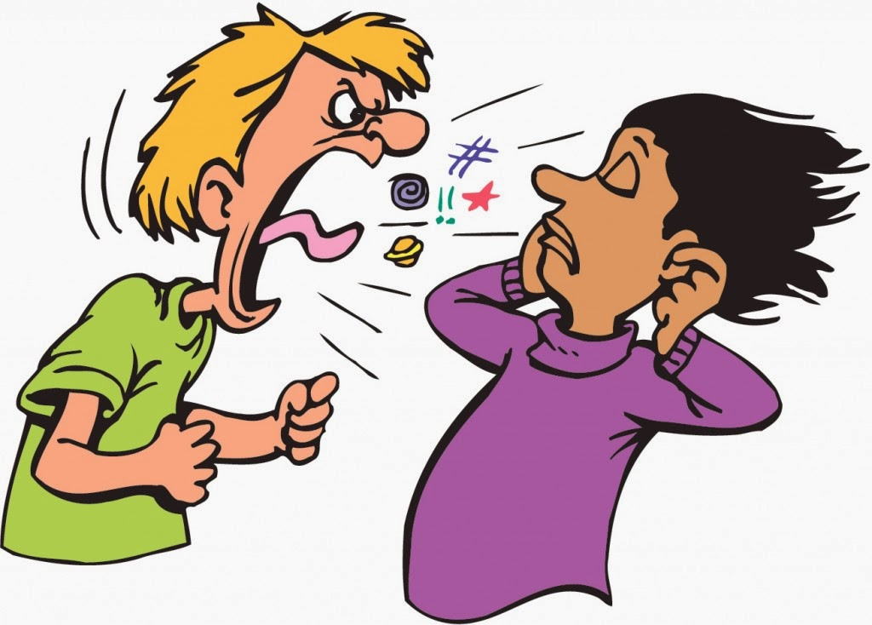
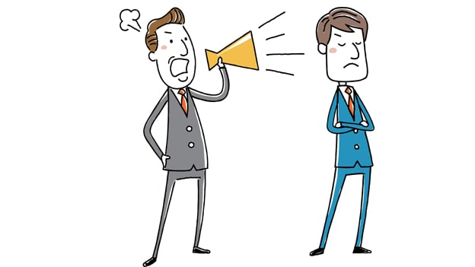
How to have GREAT conversations
AVOID:
Shouting
Silencing
Shaming
Notes:
Shouting: Reacting vs. Responding; avoid storing thing up...relate movie clip
Silencing: Not allowing others to speak OR Stonewalling- retreating, avoiding anger/conflict, emotionally withdrawing
Shaming: You are bad vs. You did something bad
Blaming
Blaming is discharging discomfort, pain, anger
Who's fault is it?
Instead, "how can we do this differently?"
Shaming
Shaming: name calling, humiliation, communicating that someone is not worthy of our respect
What are we really trying to communicate?
Empathy is an antidote. How does this feel to the other?
You are bad vs you did something bad.
Examples

Slide 16
REMEMBER!
Close relationships involve discomfort.
Setting boundaries involves discomfort.
Disagreeing involves discomfort.
Asserting your needs involves discomfort.
Notes:
Sitting with our emotions and discomfort can be challenging but it’s a skill that can be learned and practiced.
Intervene vs Accept

Slide 17
Questions, thOUGHTS?

Slide 18
References
Hawkins, S., Yudkin, D., Juan-Torres, M., & Dixon, T. (2018). The Hidden Tribes: A Study of America's Polarized Landscape. New York, New York.
Turkle, S. (2012, April 3). Connected But Alone TED Talk.
University of Pittsburgh. (2015-2020). Department of Communication. Retrieved from University of Pittsburgh: https://www.comm.pitt.edu/myths-about-conflict
Wilde, O. (Director). (2019). Booksmart [Motion Picture].

